Slide 1
Phase 1
Implementation of the Paper’s Model

Slide 2
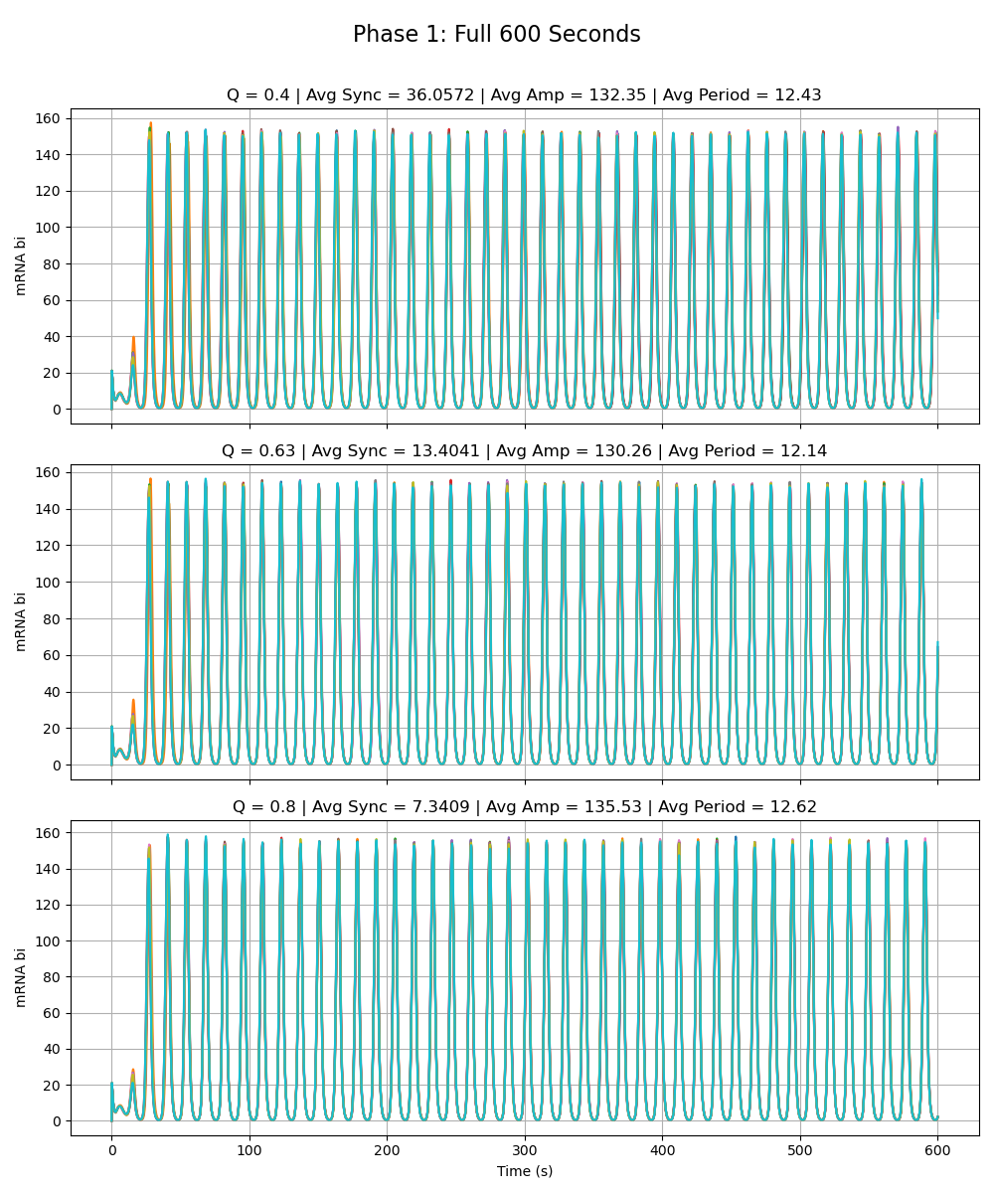
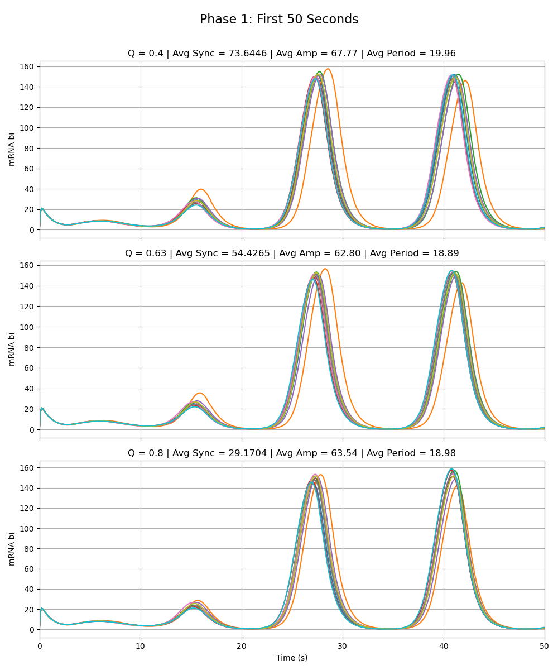
Paper’s Model
Notes:
Phase 1

Slide 3
Phase 2a – Node W
Adriana

Slide 4
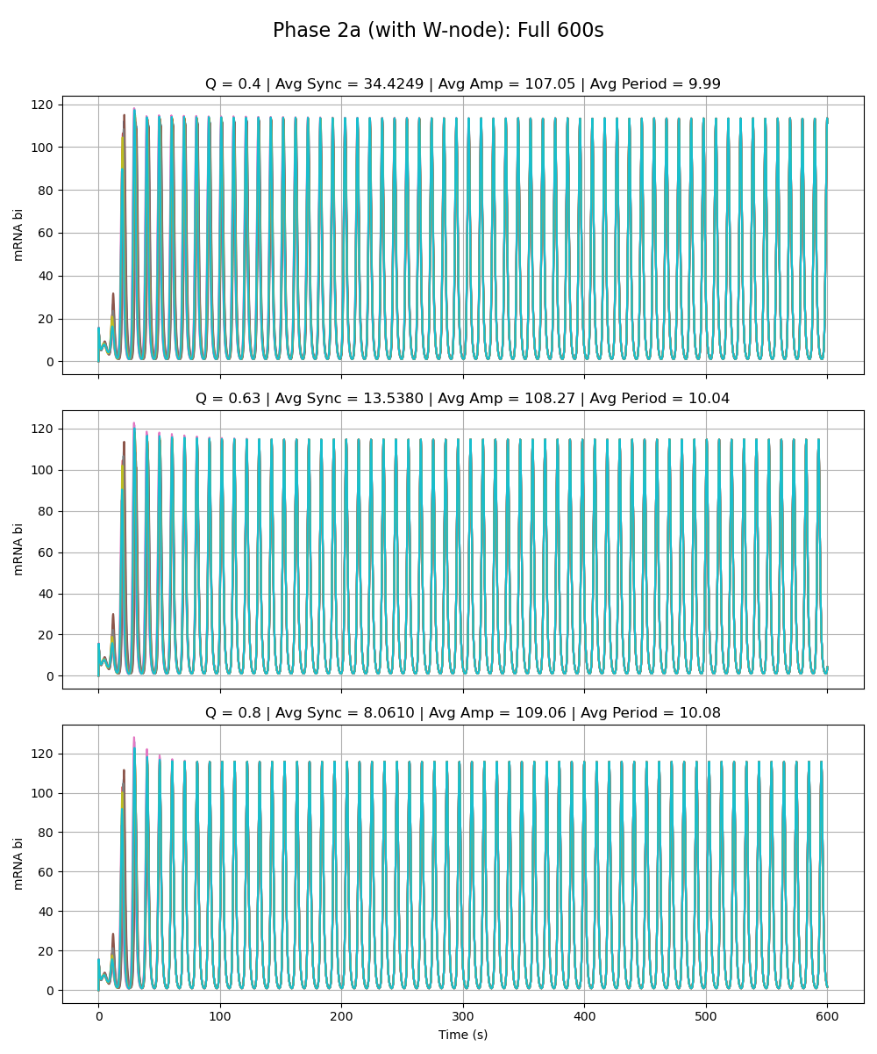
Weak Added Node
Notes:
Phase 2a – added link is very weak (max rate of w transcription is very low 0.01 vs. max rate for the rest as given by paper 216)

Slide 5
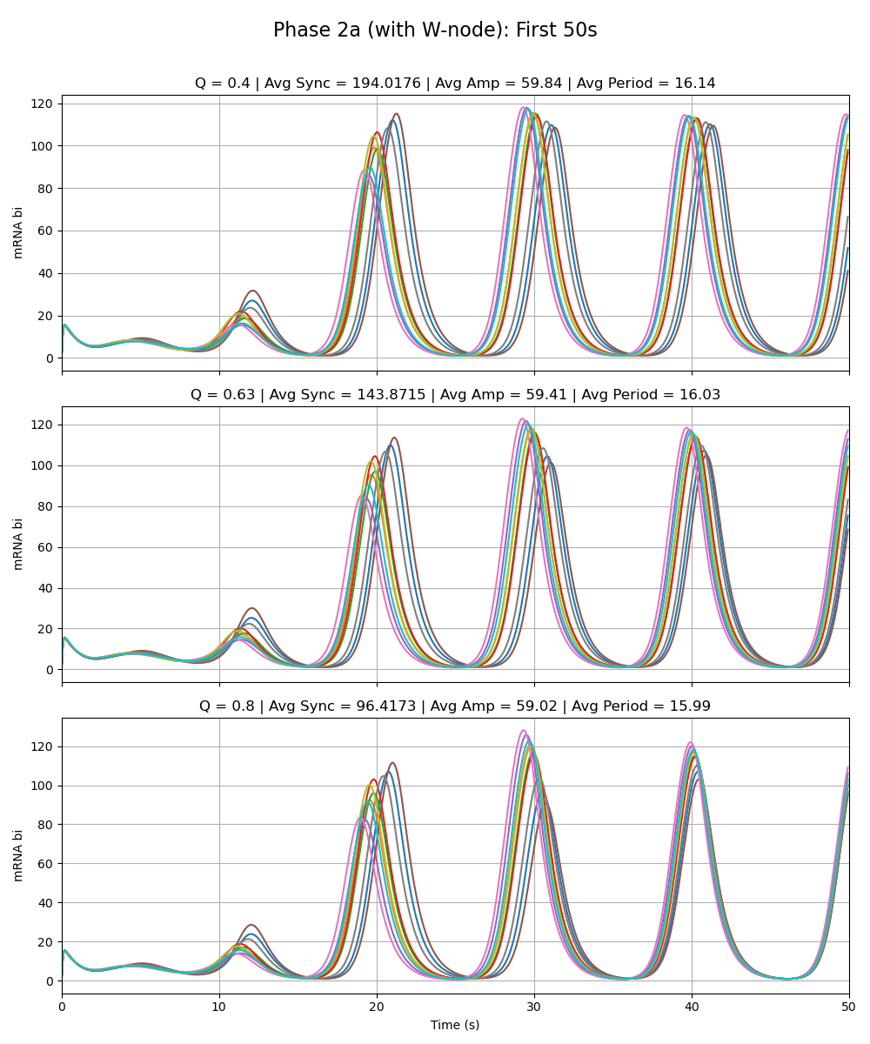
Weak Added Node
Notes:
Phase 2a – added link is very weak (max rate of w transcription is very low 0.01 vs. max rate for the rest as given by paper 216)

Slide 6
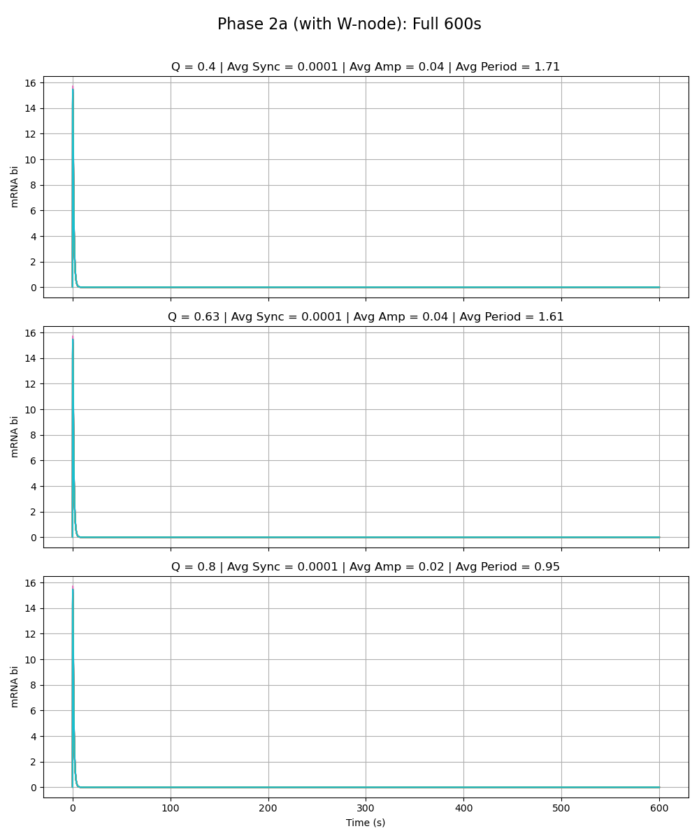
Equal Strength Added Node
Notes:
Phase 2a – added link is same strength as the rest of the circuit (max rate of w transcription is 216 vs. max rate for the rest as given by paper 216)

Slide 7
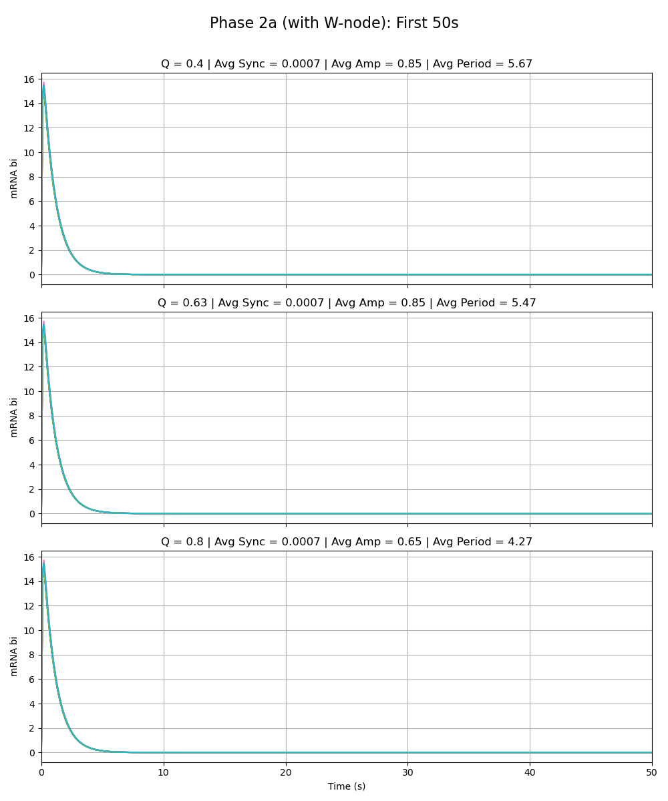
Equal Strength Added Node
Notes:
Phase 2a – added link is same strength as the rest of the circuit (max rate of w transcription is 216 vs. max rate for the rest as given by paper 216)

Slide 8
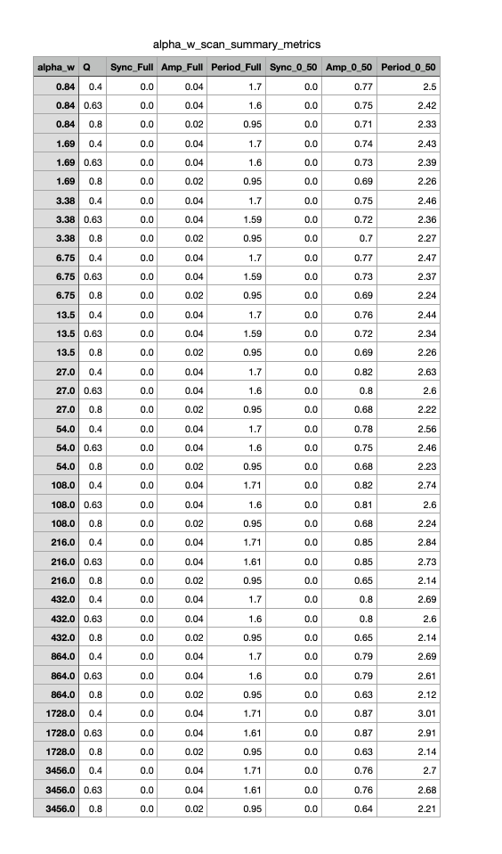
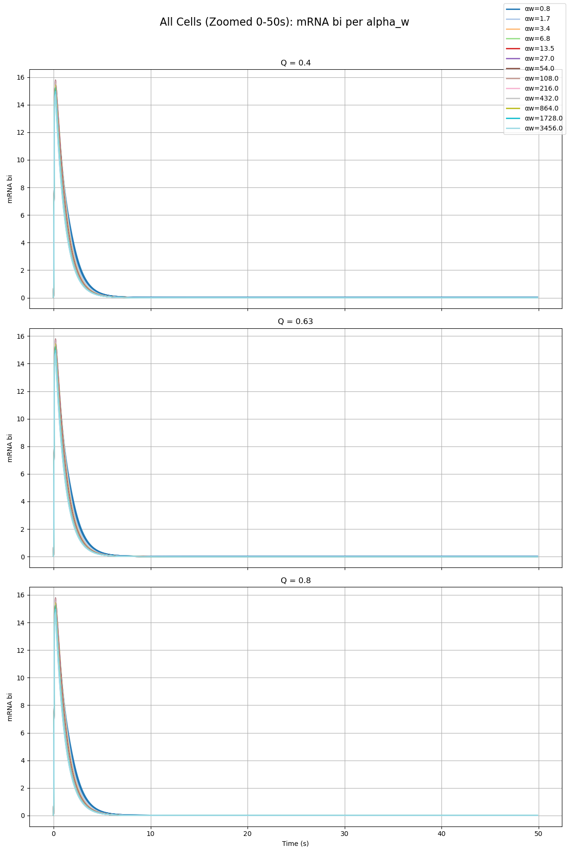
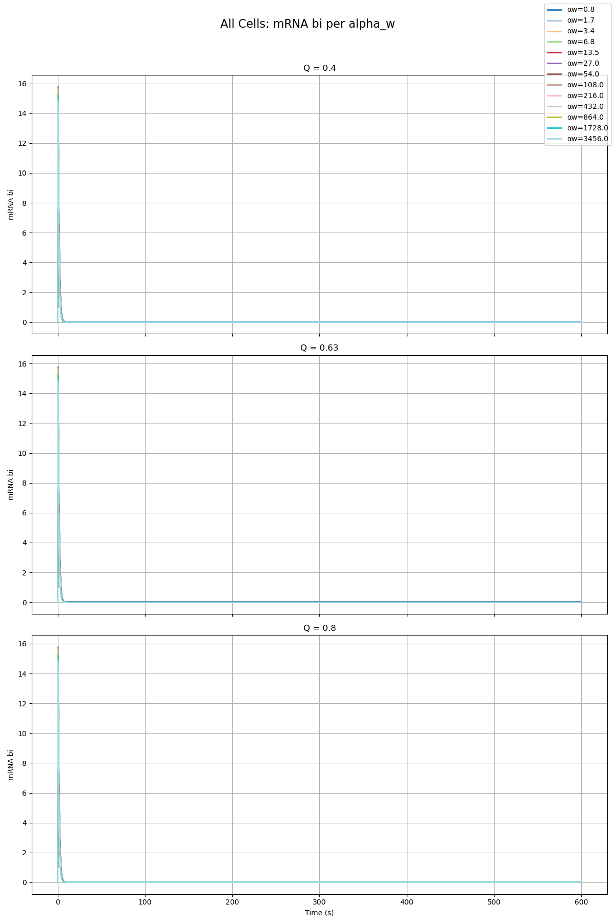
Parameter Scan

Slide 9
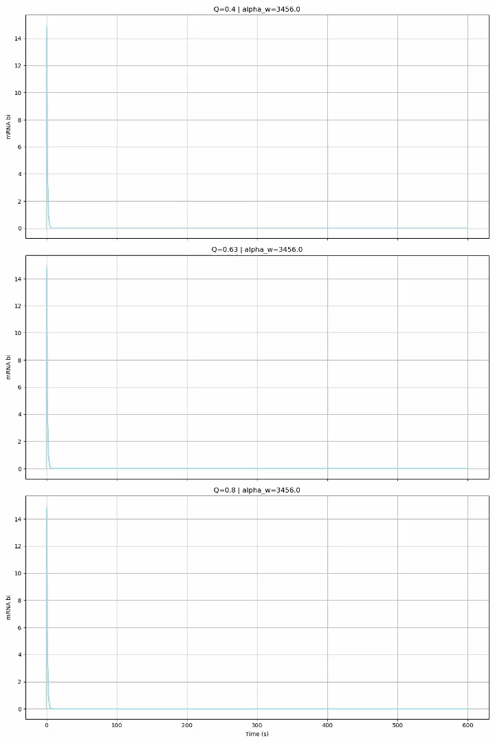
Parameter Scan

Slide 10
Phase 2a – Node X
Sydney

Slide 11
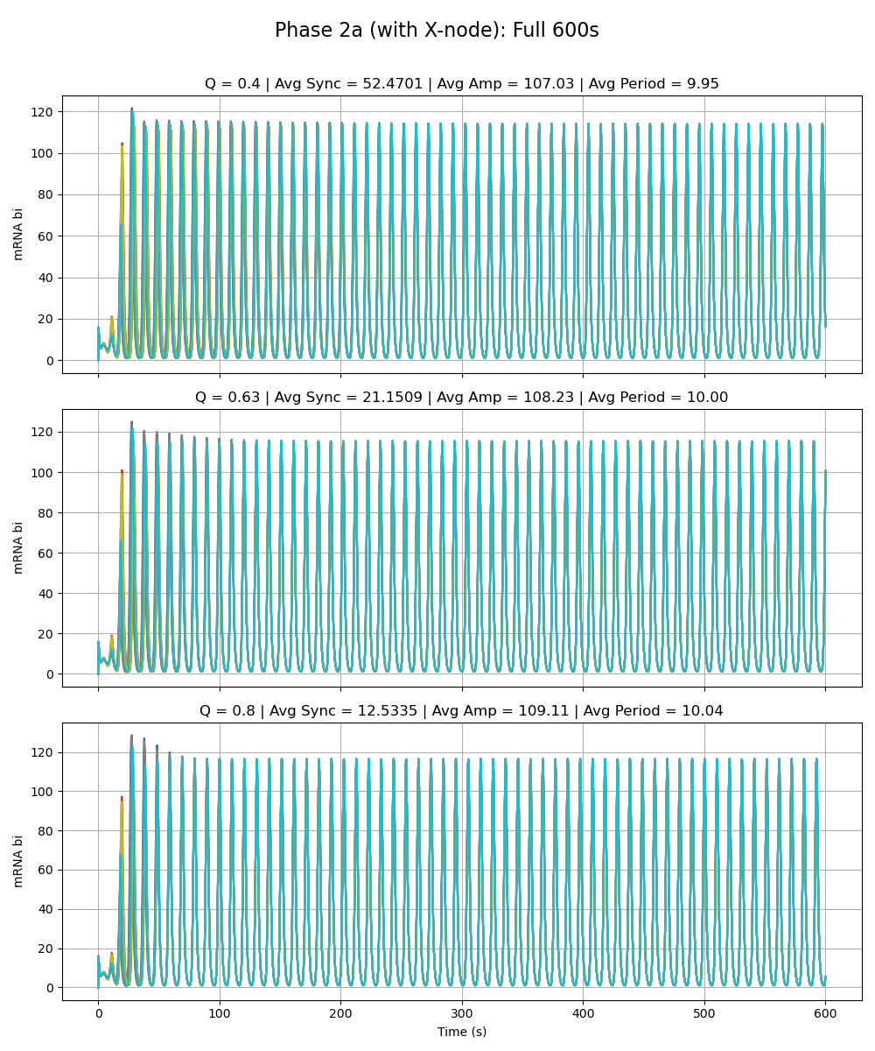
Weak Added Node
Notes:
Phase 2a – added link is very weak (max rate of x transcription is very low 0.01 vs. max rate for the rest as given by paper 216)

Slide 12
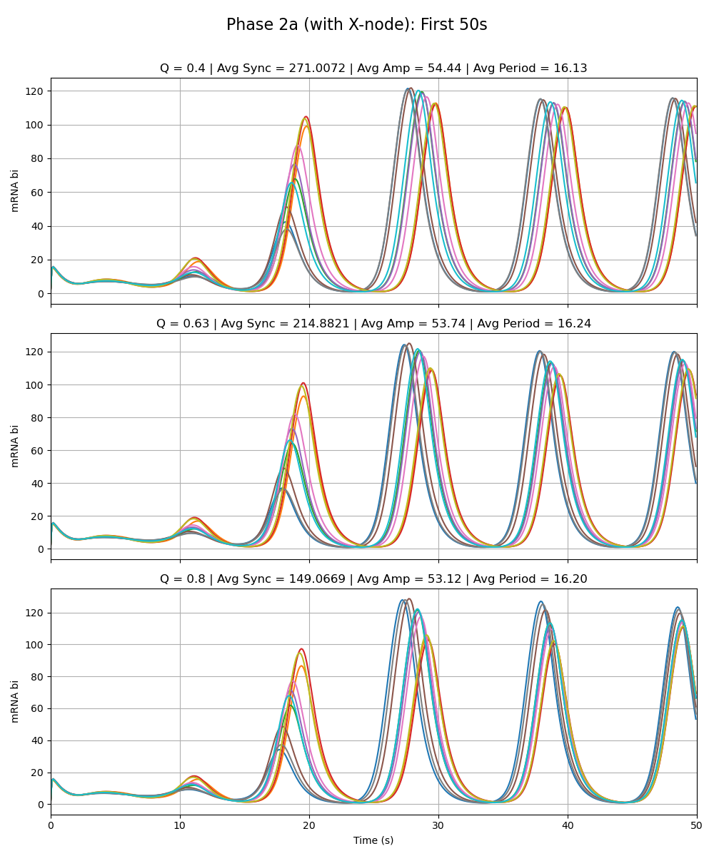
Weak Added Node
Notes:
Phase 2a – added link is very weak (max rate of x transcription is very low 0.01 vs. max rate for the rest as given by paper 216)

Slide 13
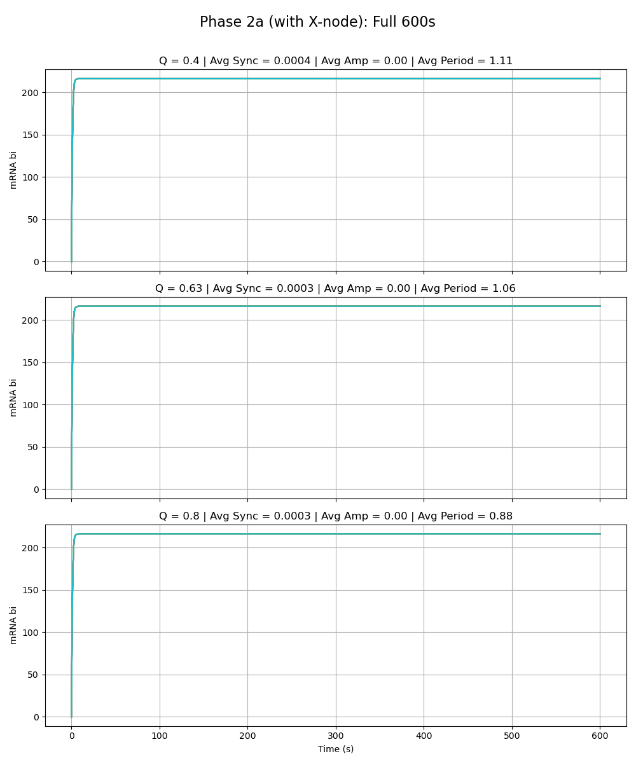
Equal Strength Added Node
Notes:
Phase 2a – added link is same strength as the rest of the circuit (max rate of x transcription is 216 vs. max rate for the rest as given by paper 216)

Slide 14
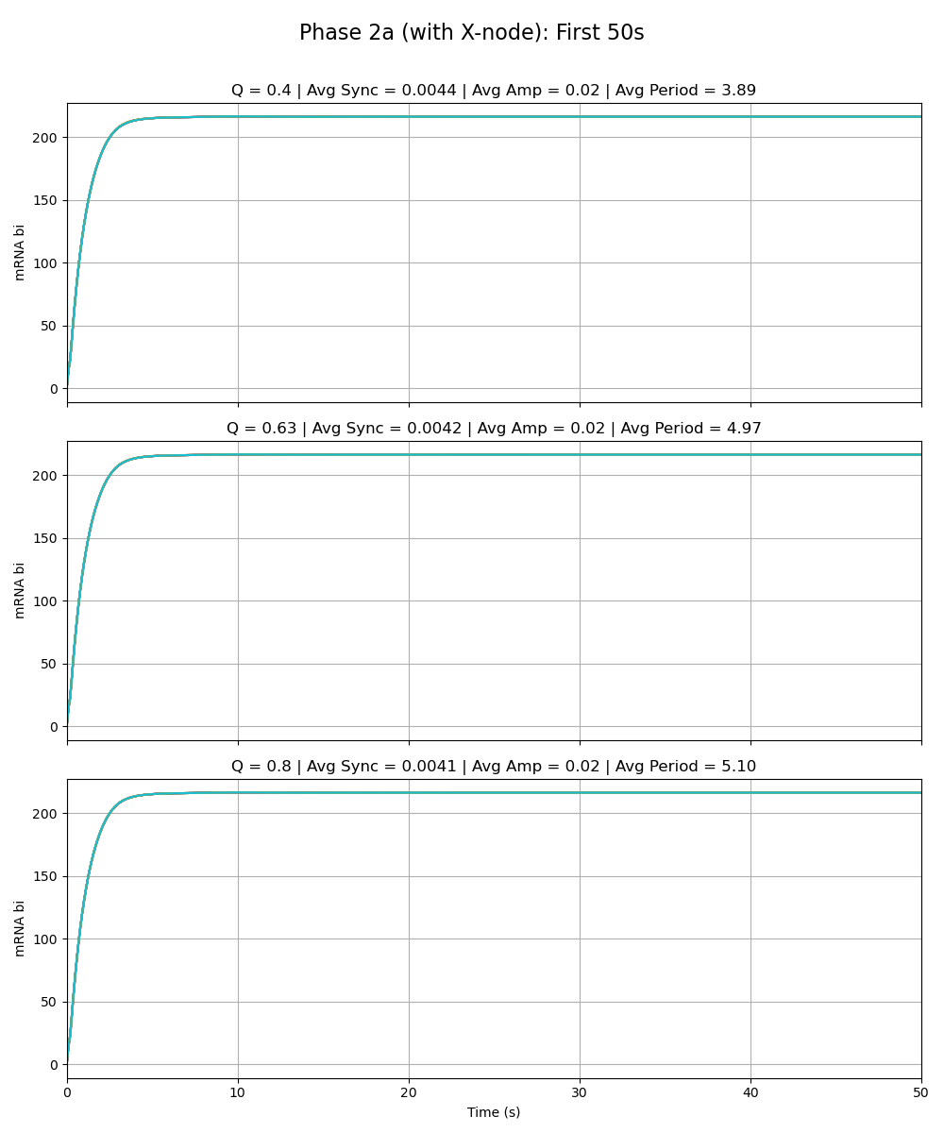
Equal Strength Added Node
Notes:
Phase 2a – added link is same strength as the rest of the circuit (max rate of x transcription is 216 vs. max rate for the rest as given by paper 216)

Slide 15
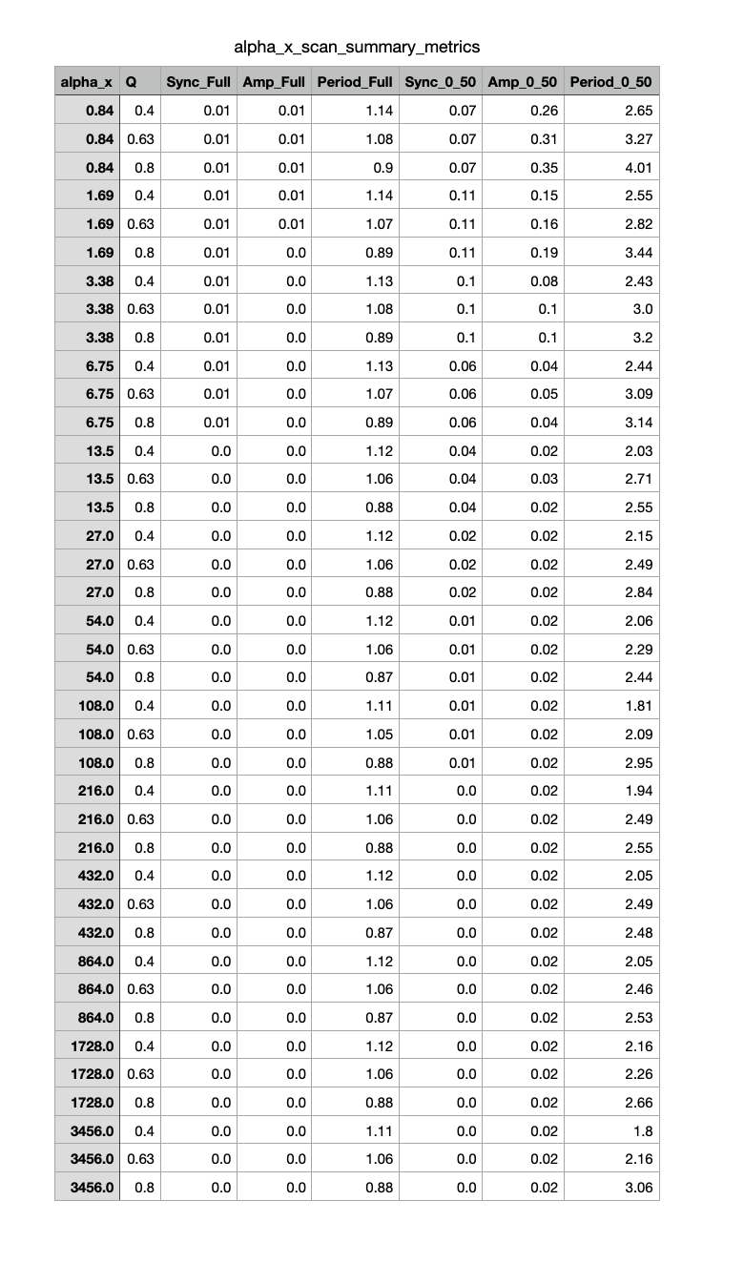
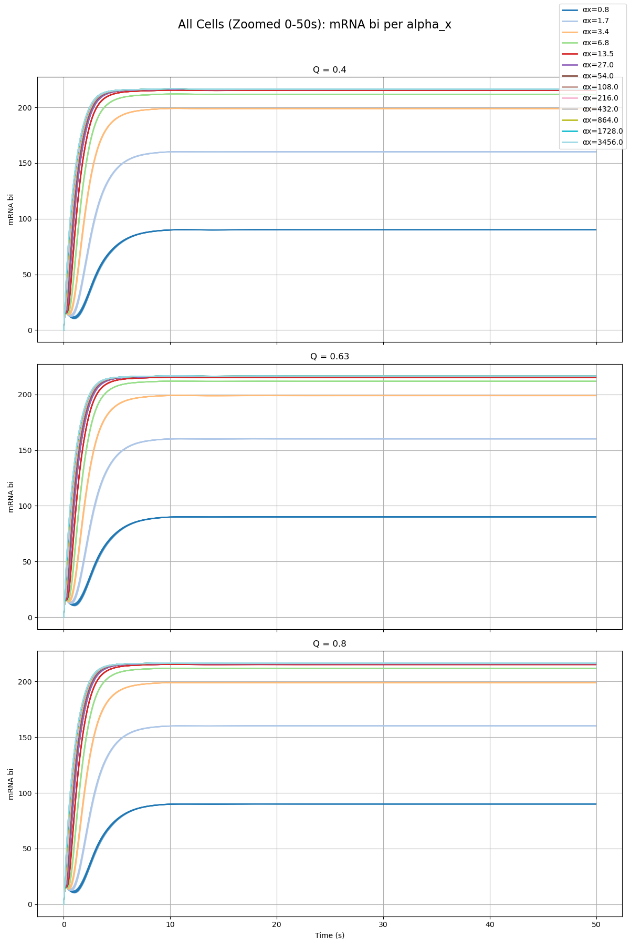
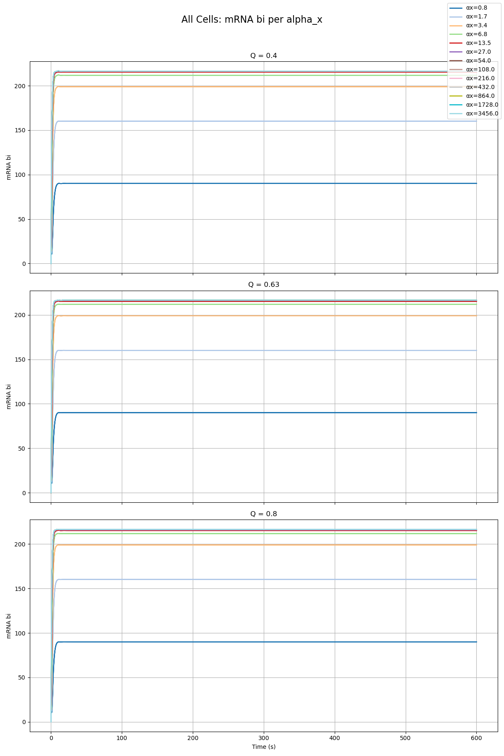
Parameter Scan

Slide 16
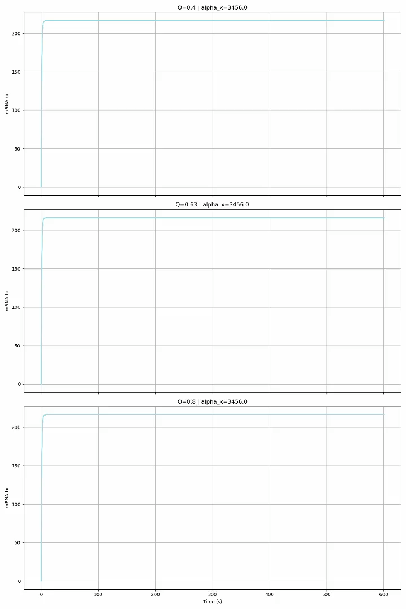
Parameter Scan

Slide 17
Phase 2a – Node Y
Sean

Slide 18
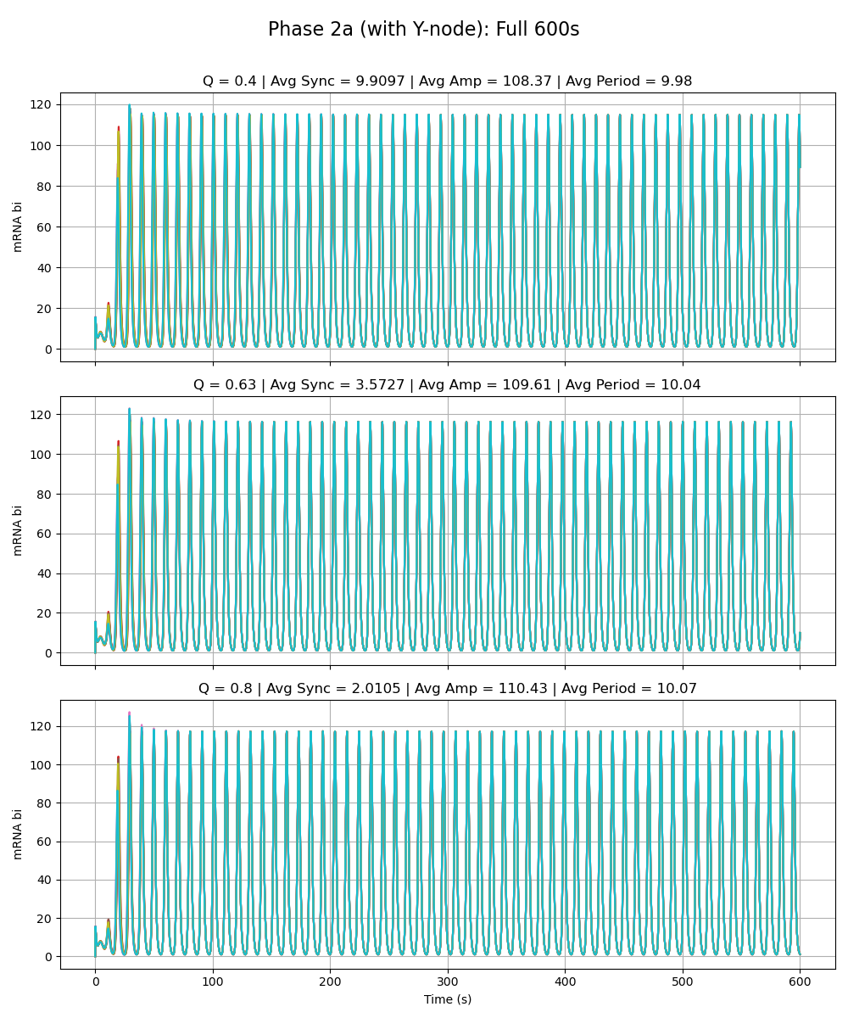
Weak Added Node
Notes:
Phase 2a – added link is very weak (max rate of y transcription is very low 0.01 vs. max rate for the rest as given by paper 216)

Slide 19
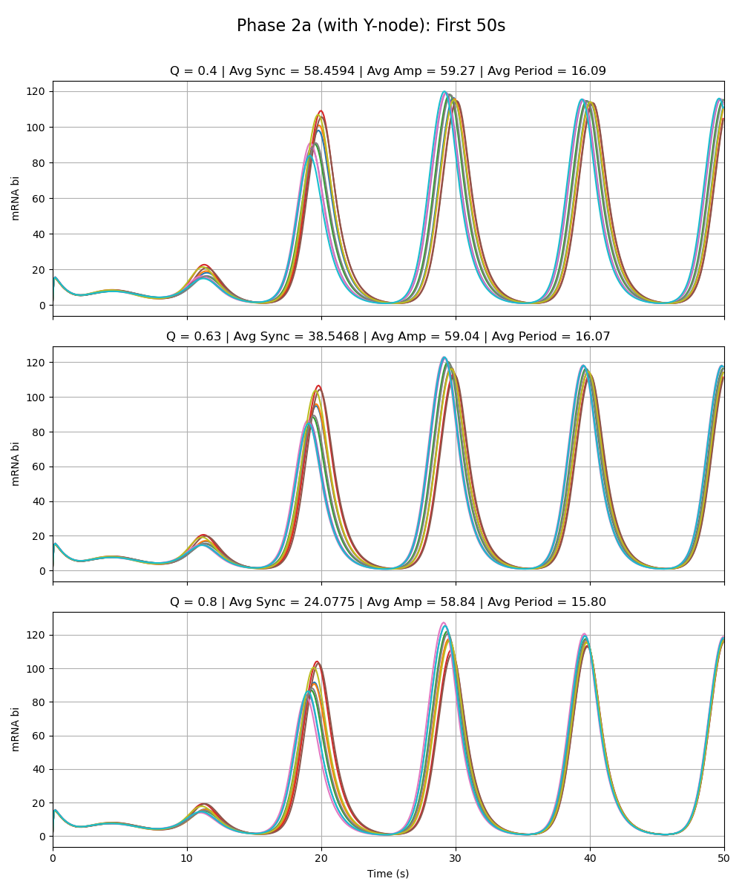
Weak Added Node
Notes:
Phase 2a – added link is very weak (max rate of y transcription is very low 0.01 vs. max rate for the rest as given by paper 216)

Slide 20
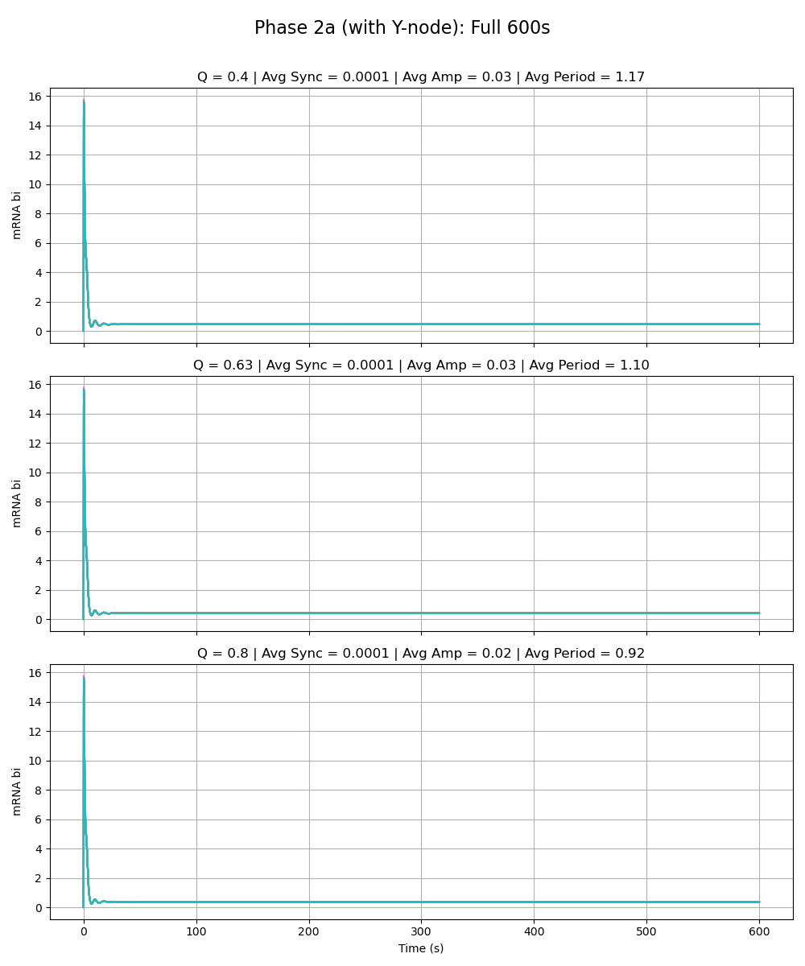
Equal Strength Added Node
Notes:
Phase 2a – added link is same strength as the rest of the circuit (max rate of y transcription is 216 vs. max rate for the rest as given by paper 216)

Slide 21
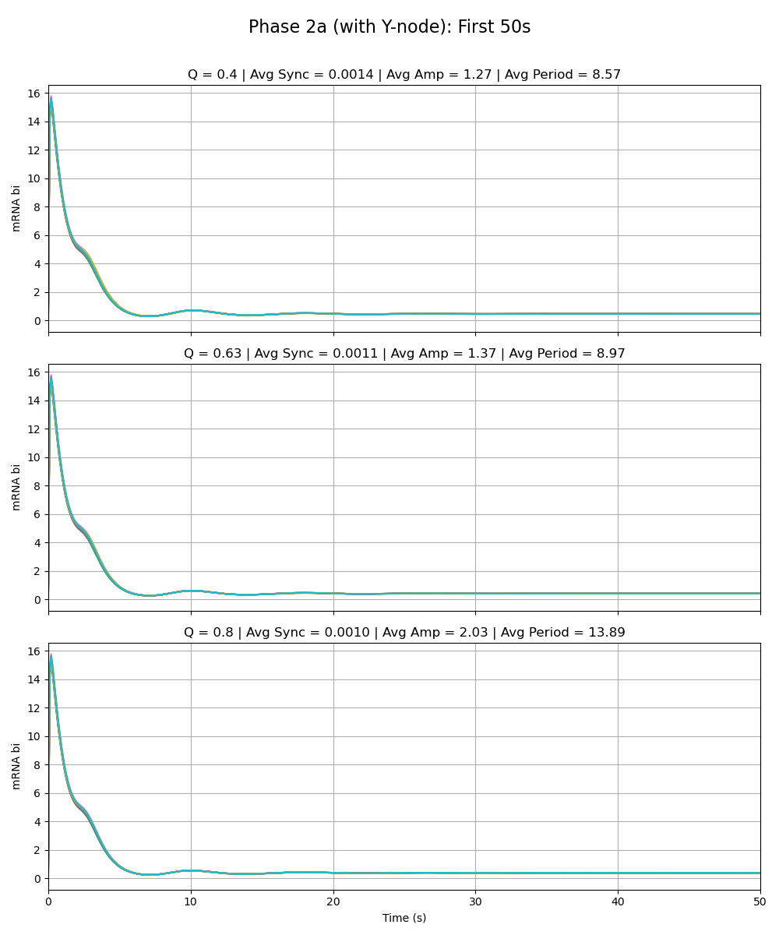
Equal Strength Added Node
Notes:
Phase 2a – added link is same strength as the rest of the circuit (max rate of y transcription is 216 vs. max rate for the rest as given by paper 216)

Slide 22
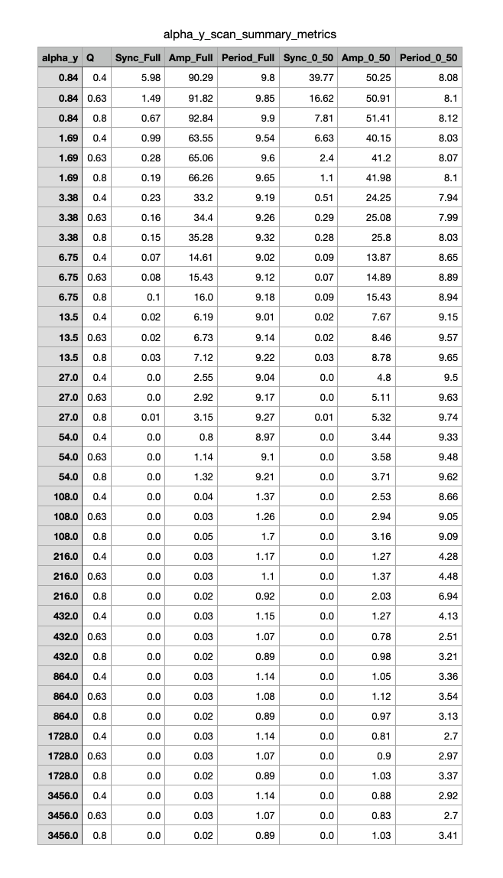
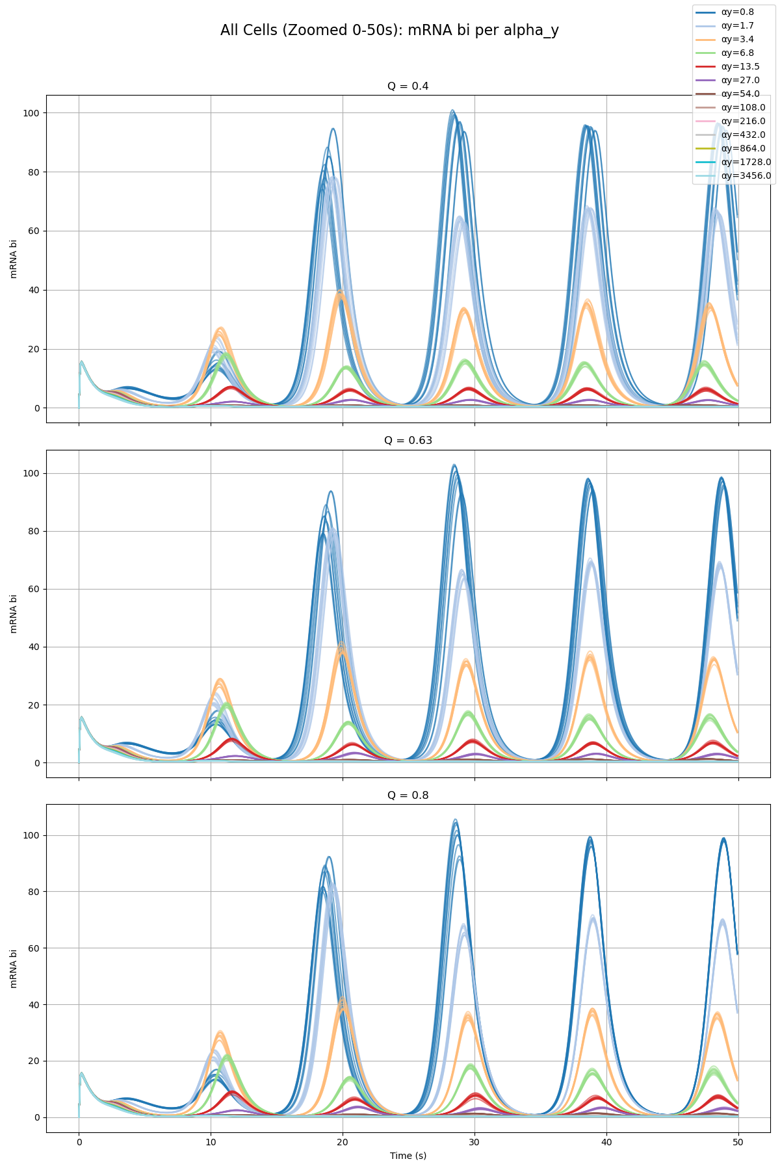
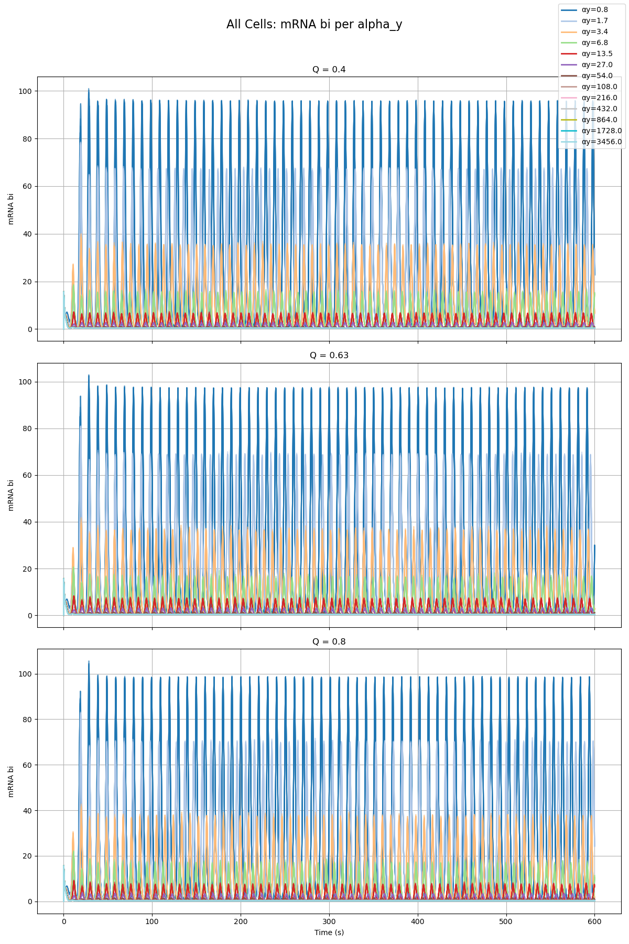
Parameter Scan

Slide 23
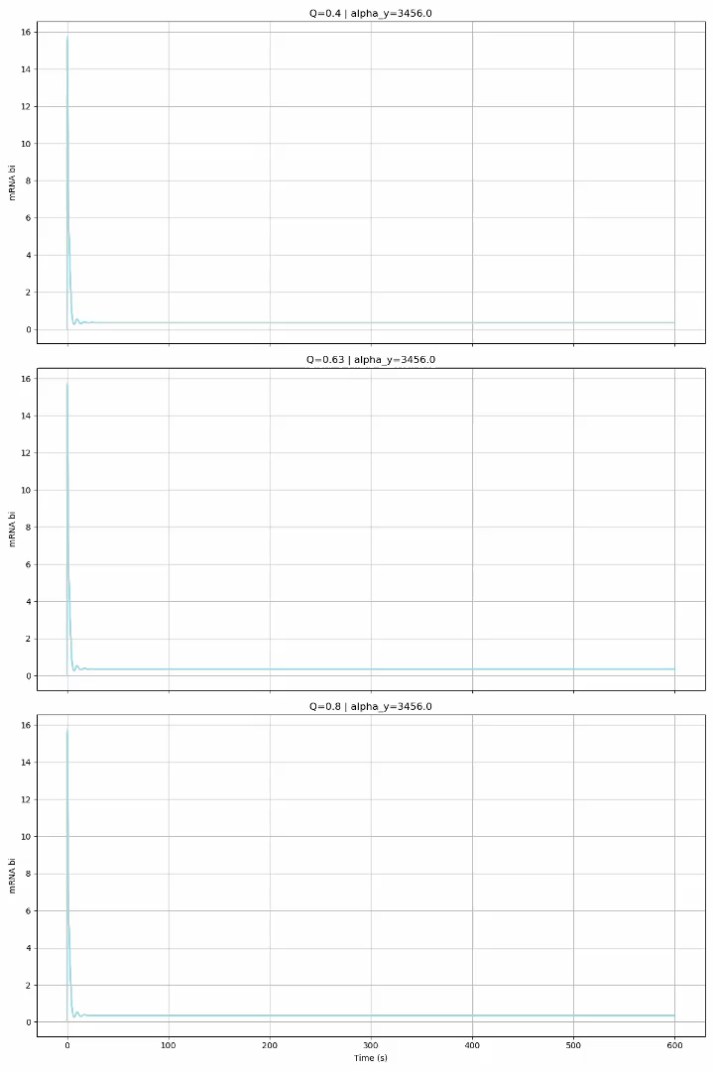
Parameter Scan

Slide 24
Phase 2a – Node Z
Olivia

Slide 25

Weak Added Node
Notes:
Phase 2a – added link is very weak (max rate of z transcription is very low 0.01 vs. max rate for the rest as given by paper 216)

Slide 26
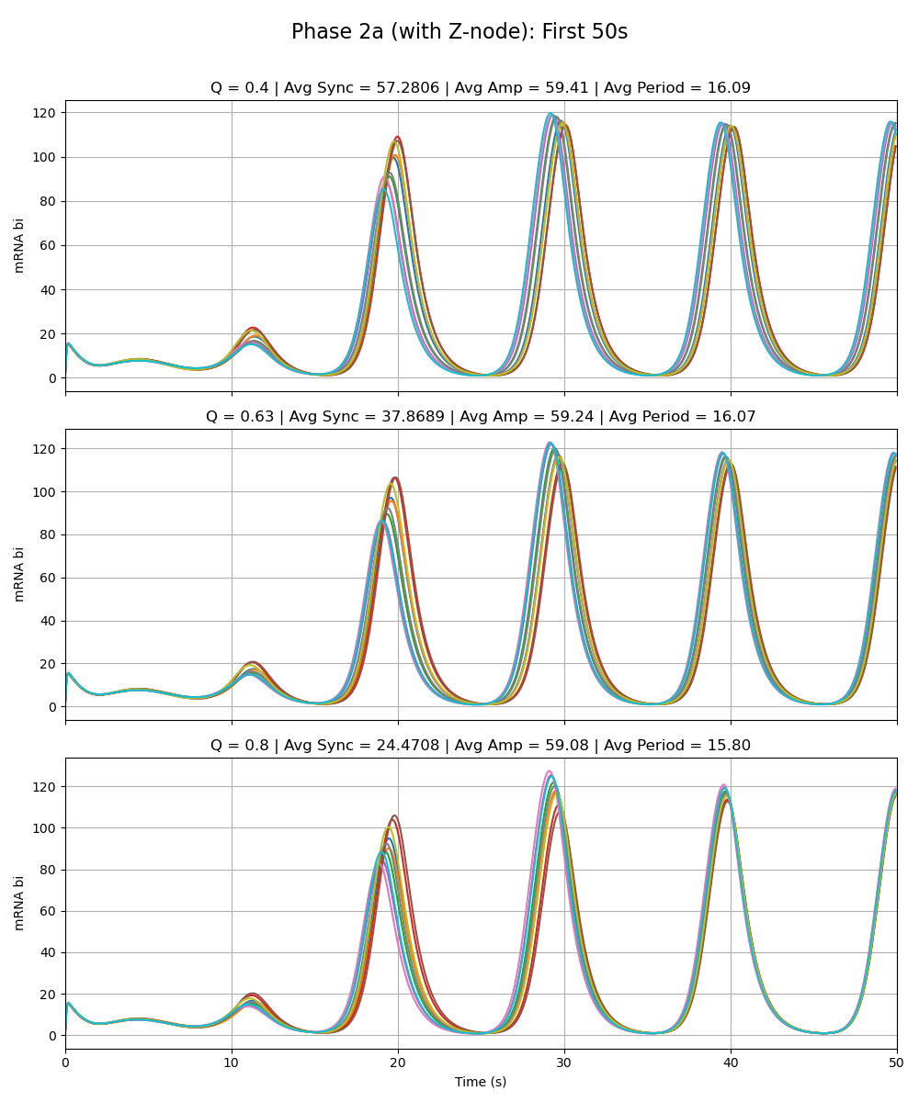
Weak Added Node
Notes:
Phase 2a – added link is very weak (max rate of z transcription is very low 0.01 vs. max rate for the rest as given by paper 216)

Slide 27
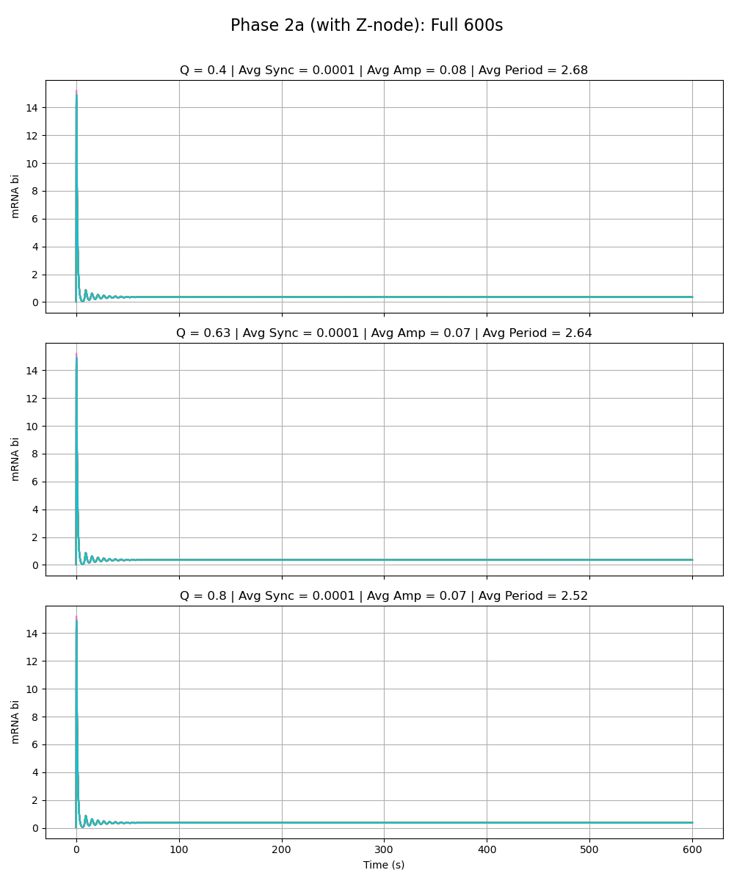
Equal Strength Added Node
Notes:
Phase 2a – added link is same strength as the rest of the circuit (max rate of z transcription is 216 vs. max rate for the rest as given by paper 216)

Slide 28
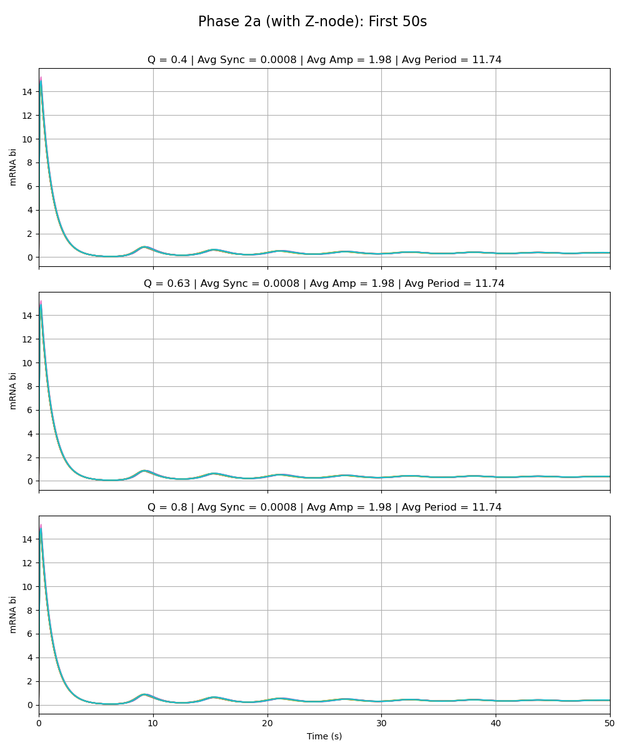
Equal Strength Added Node
Notes:
Phase 2a – added link is same strength as the rest of the circuit (max rate of z transcription is 216 vs. max rate for the rest as given by paper 216)

Slide 29
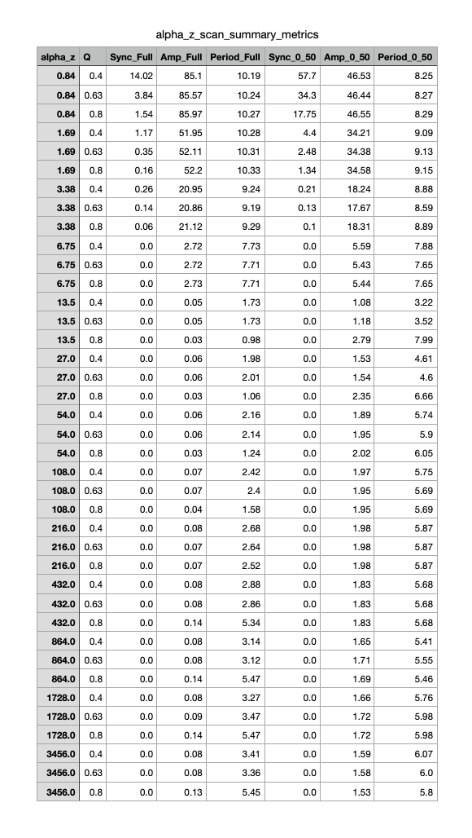
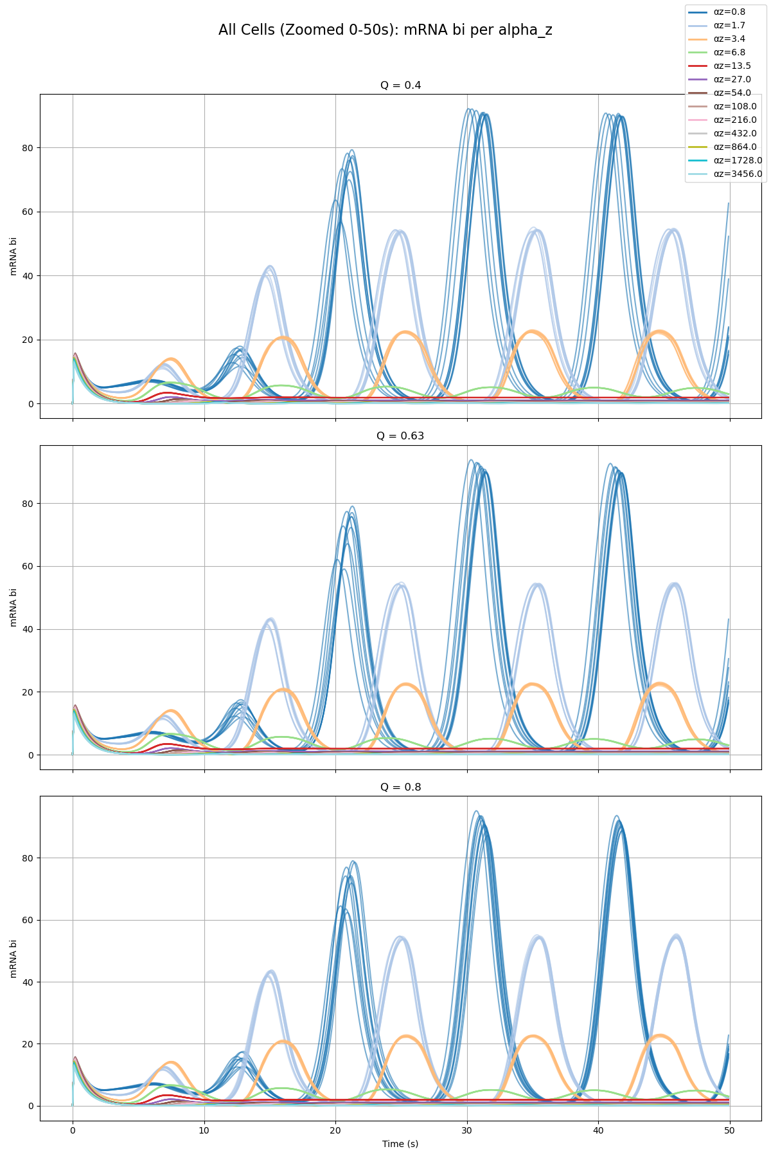
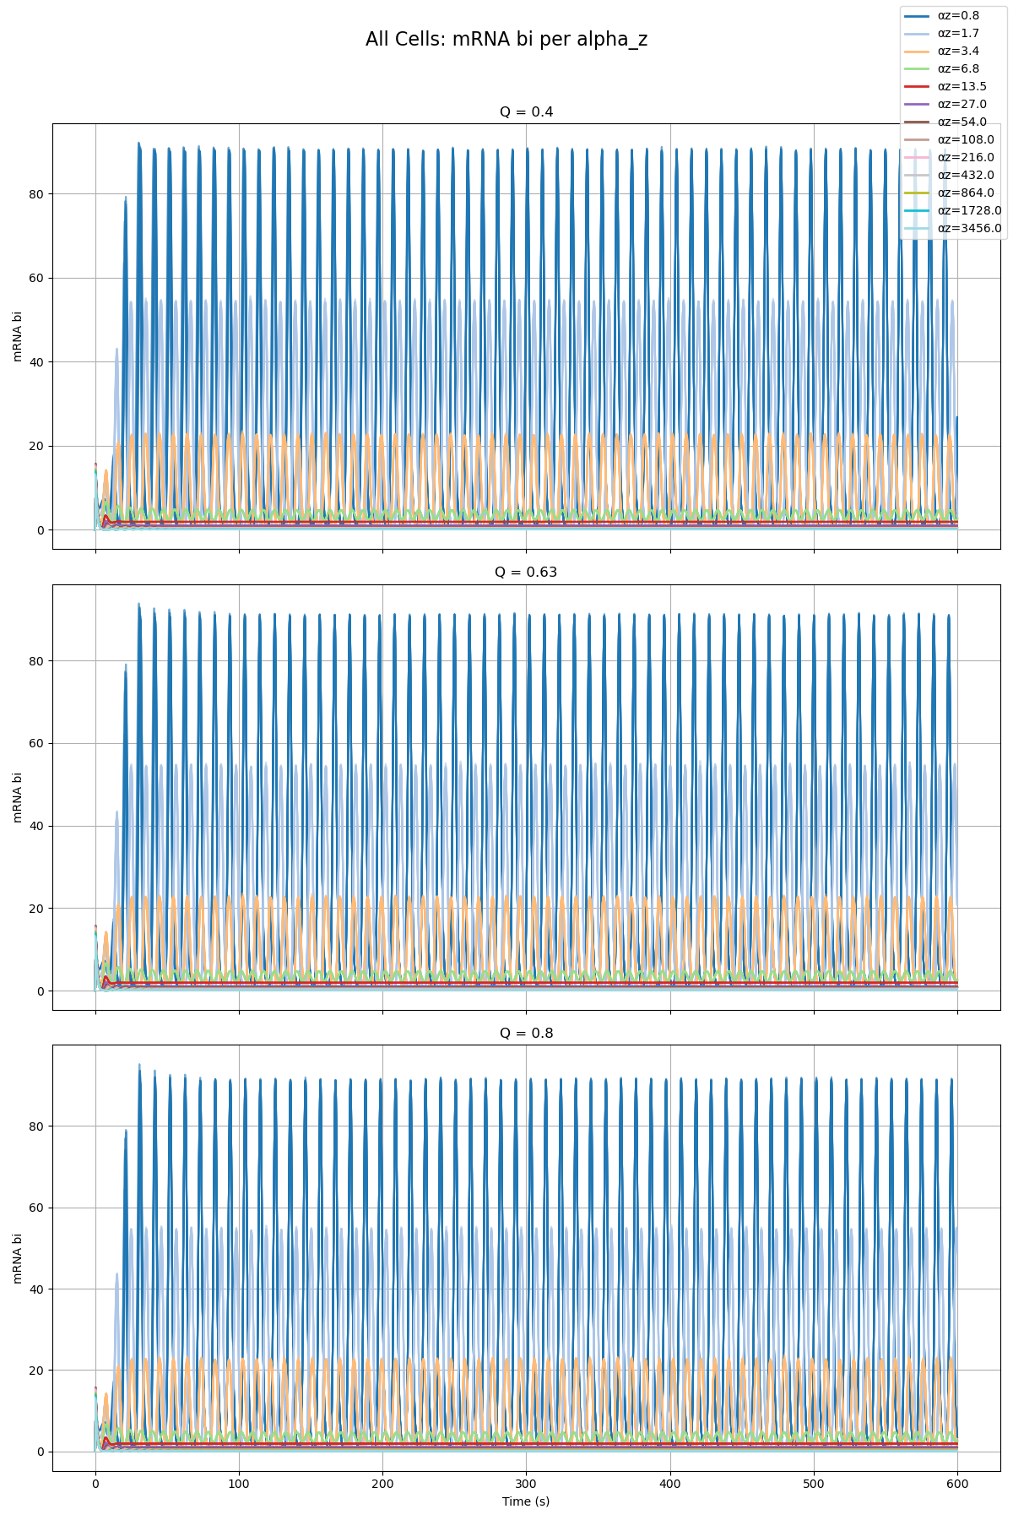
Parameter Scan

Slide 30
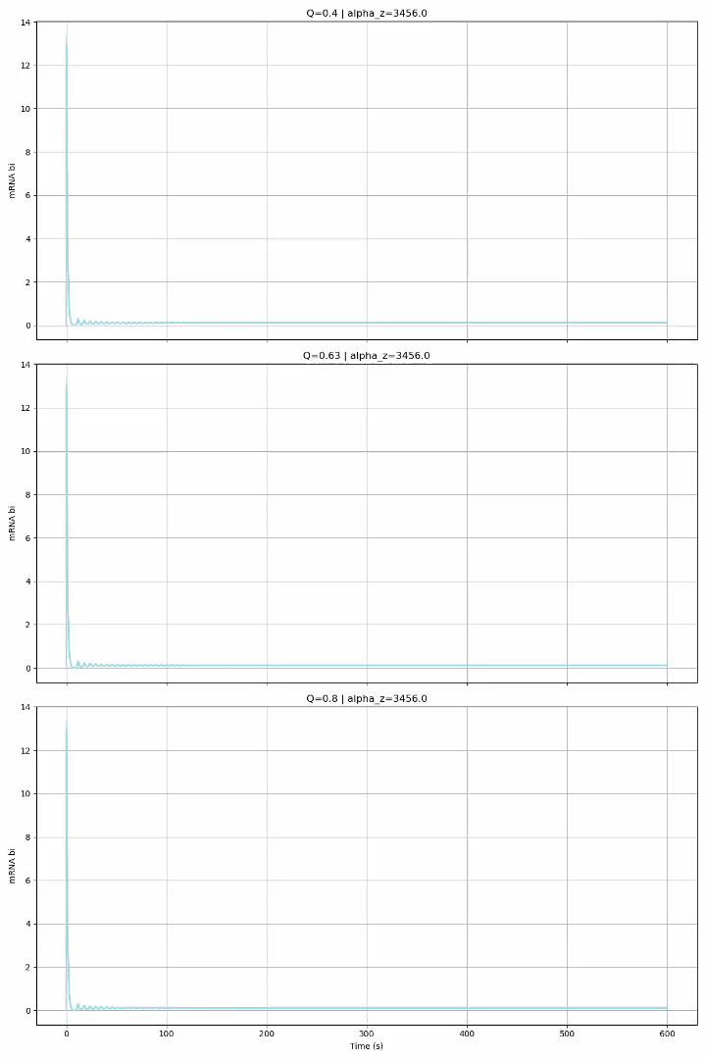
Parameter Scan

Slide 31
Phase 2a Summary

Slide 32
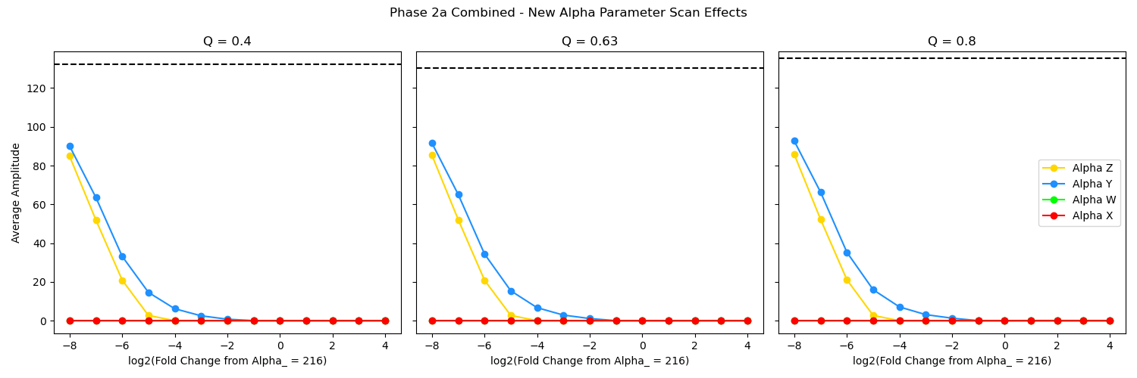
Adding Node Y (parameter sweep of alpha y) has the smallest effect on each of our individual models, followed by Node Z, with Nodes W and X having the most drastic effect.

Slide 33
Phase 2b – Group Model

Slide 34
Paper Model vs. Group Model Alpha_W = 0.01 Alpha_X = 0.01 Alpha_Y = 0.01 Alpha_Z = 0.01

Slide 35
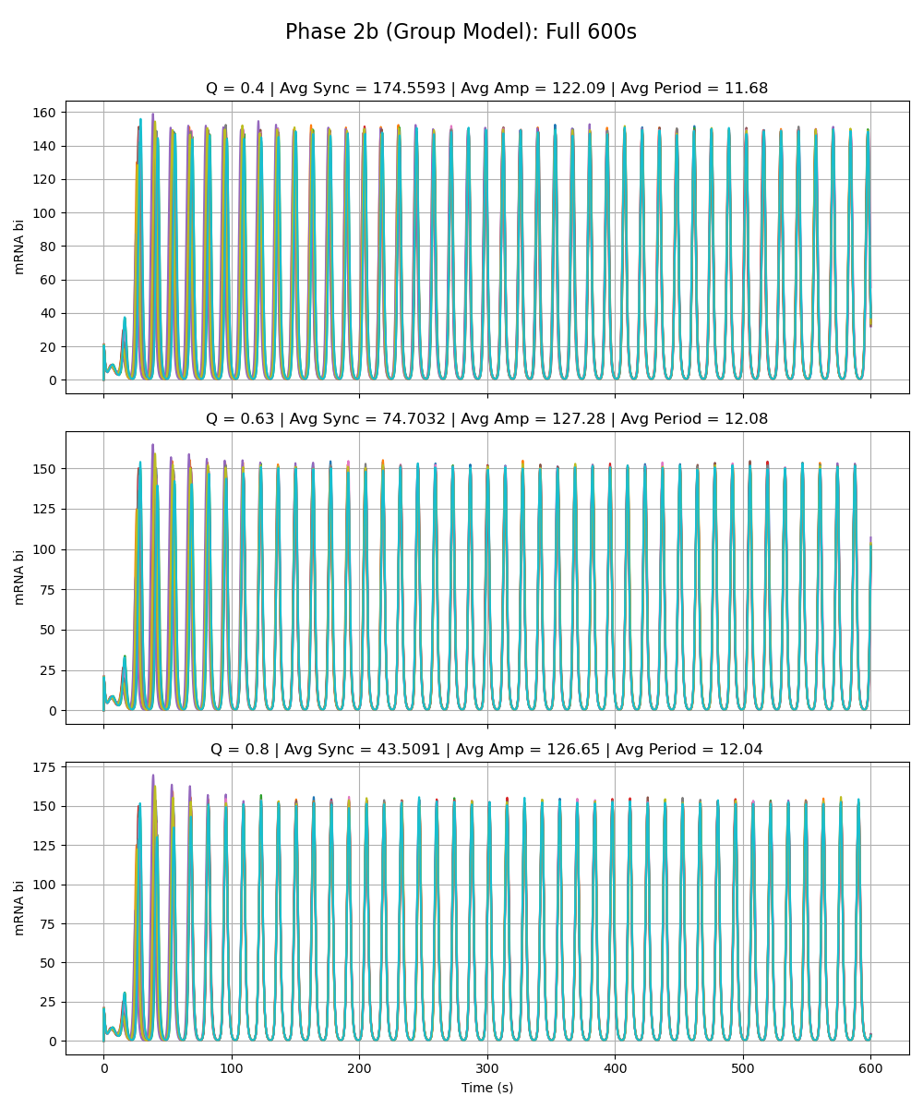
Notes:
All special alphas are 0.01

Slide 36
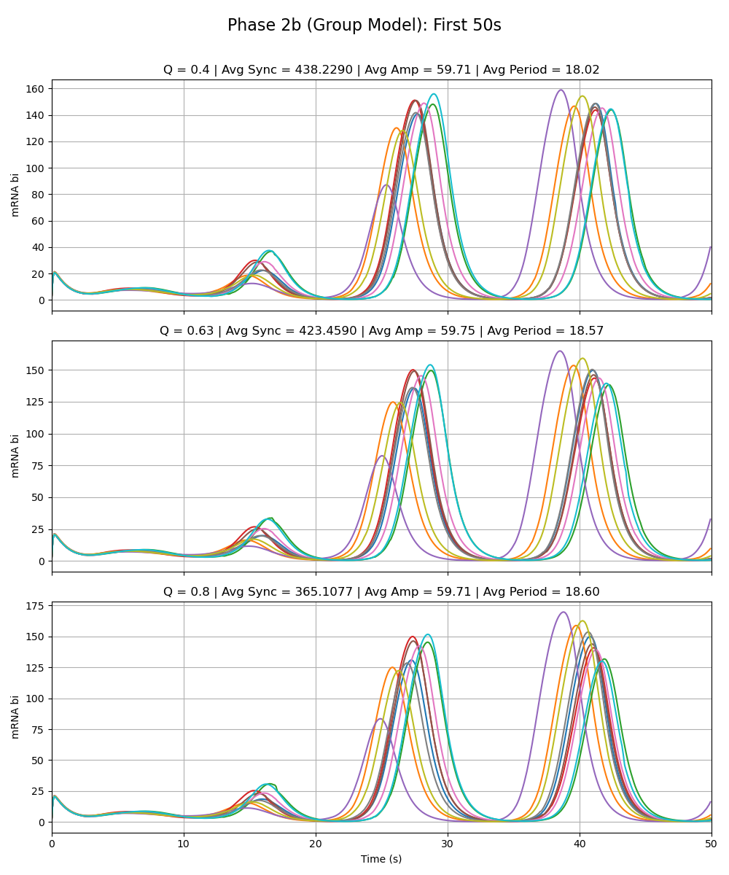
Notes:
All special alphas are 0.01

Slide 37
Adriana Phase 2a Model vs. Group Model Alpha_W = 216 Alpha_X = 0.01 Alpha_Y = 0.01 Alpha_Z = 0.01

Slide 38
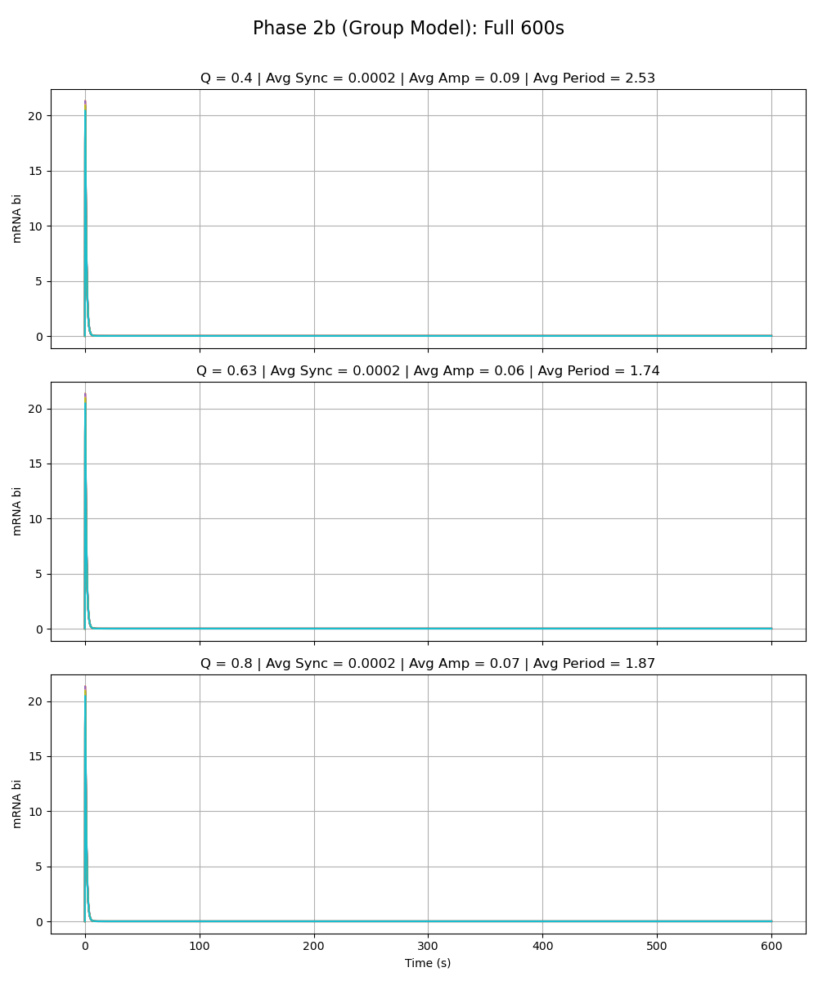
Notes:
alpha_w is 216

Slide 39
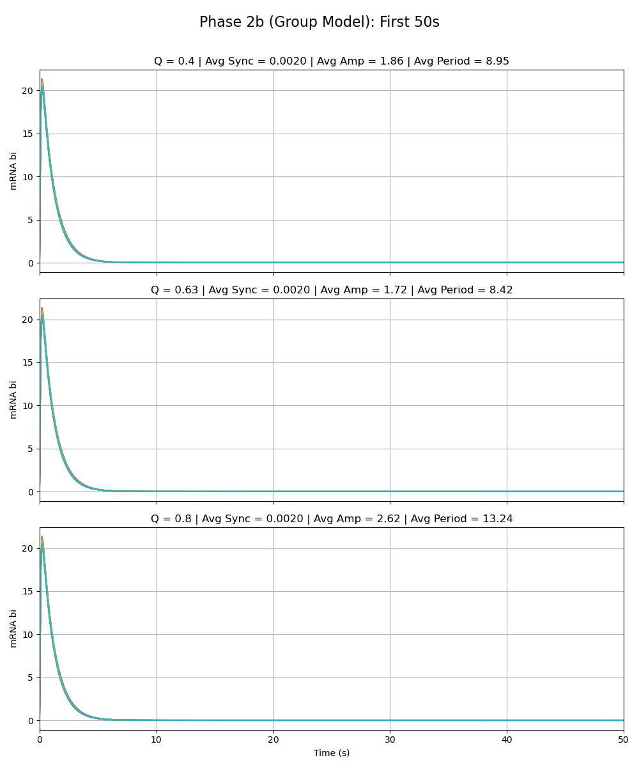
Notes:
alpha_w is 216

Slide 40
Sydney Phase 2a Model vs. Group Model Alpha_W = 0.01 Alpha_X = 216 Alpha_Y = 0.01 Alpha_Z = 0.01

Slide 41
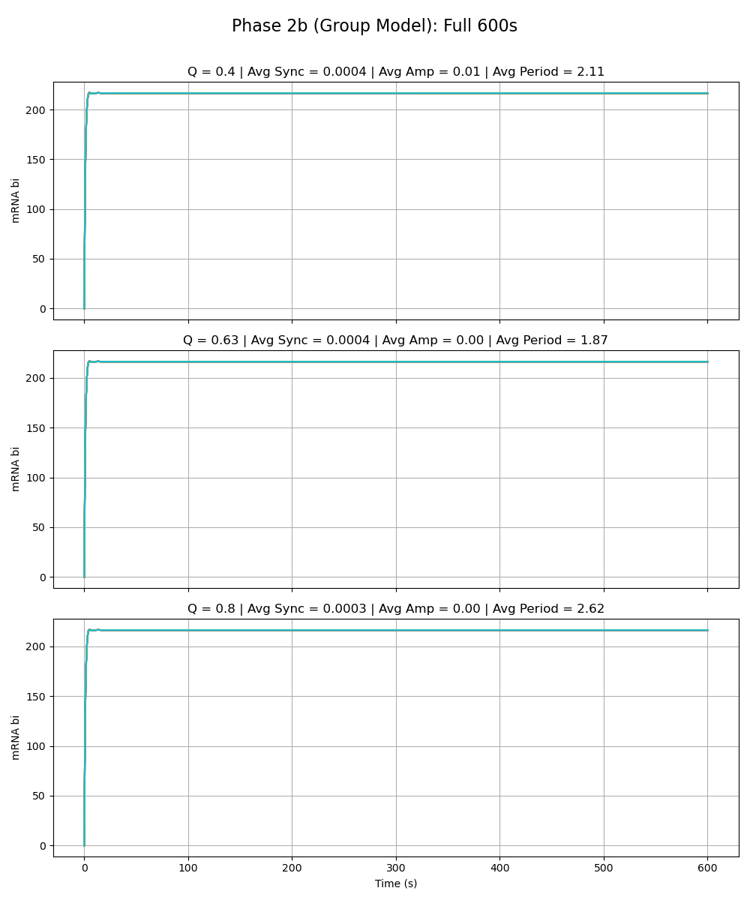
Notes:
alpha_x is 216

Slide 42
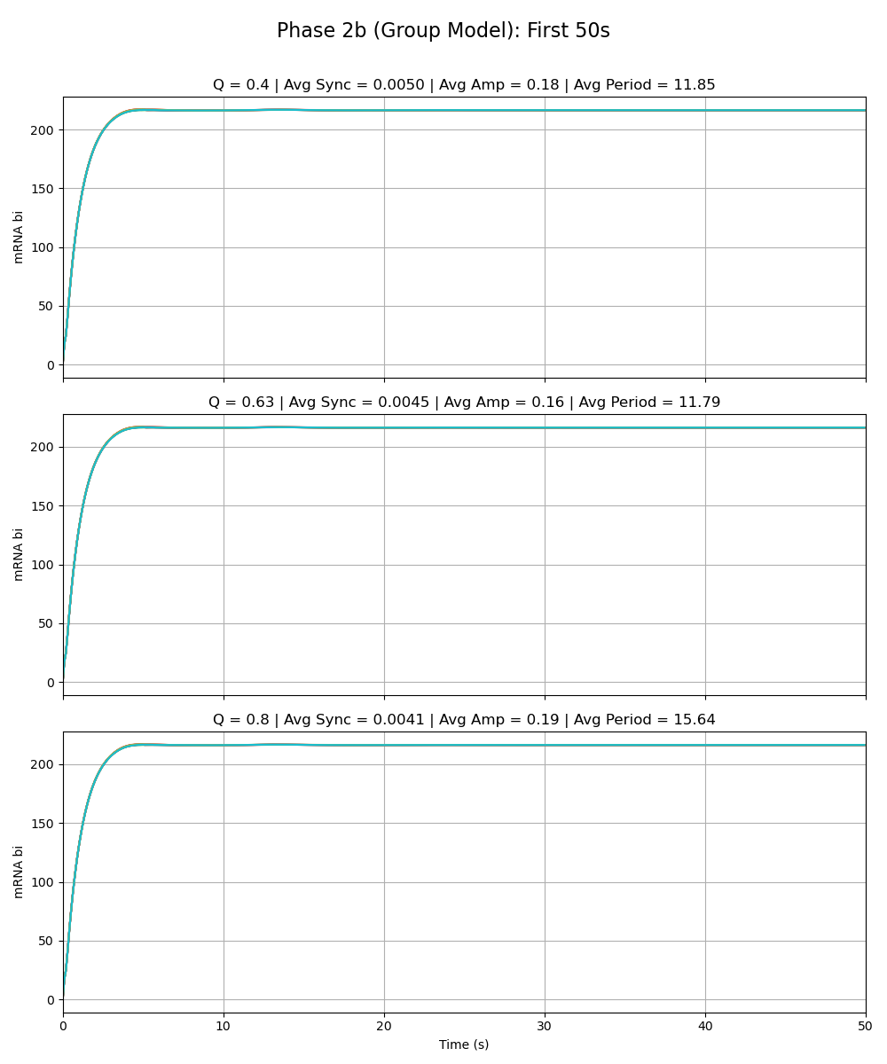
Notes:
alpha_x is 216

Slide 43
Sean Phase 2a Model vs. Group Model Alpha_W = 0.01 Alpha_X = 0.01 Alpha_Y = 216 Alpha_Z = 0.01

Slide 44
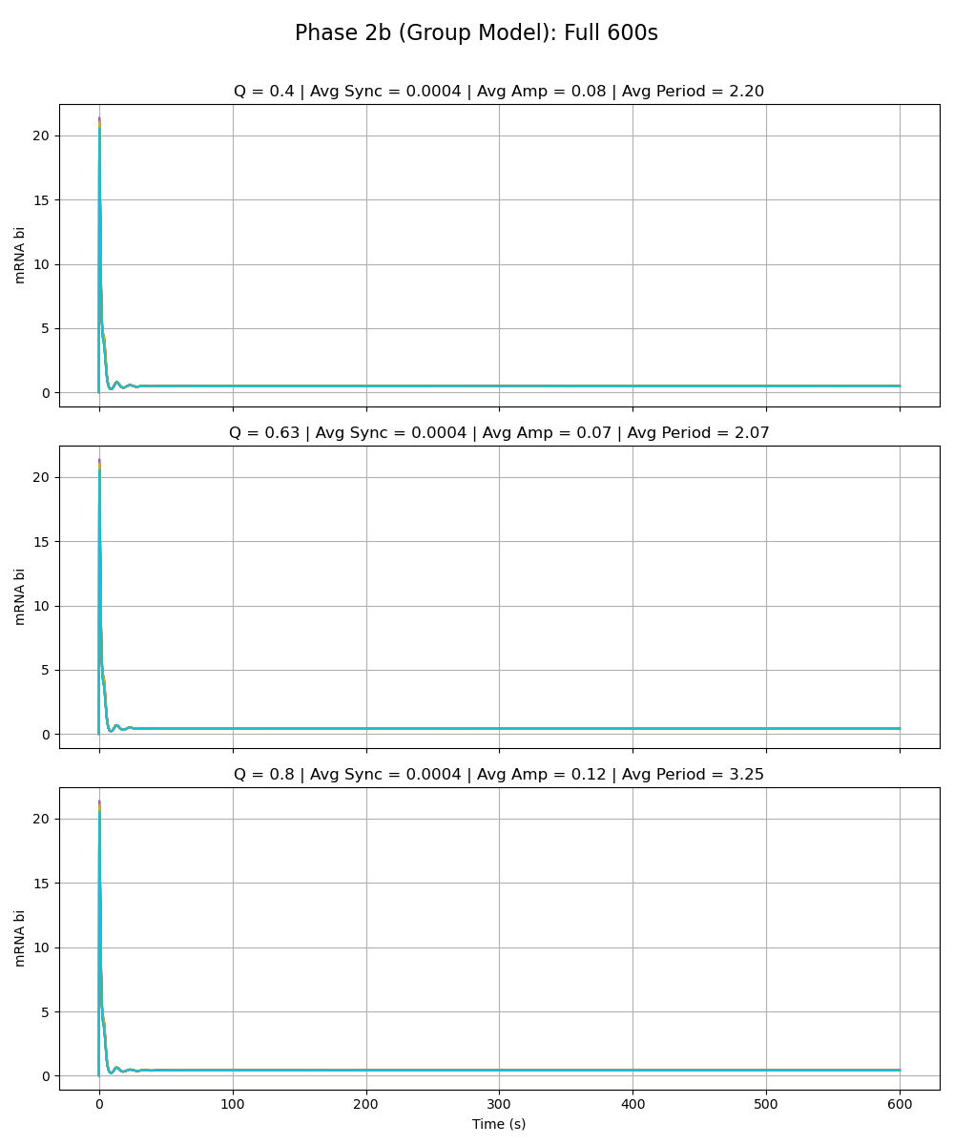
Notes:
alpha_y is 216

Slide 45
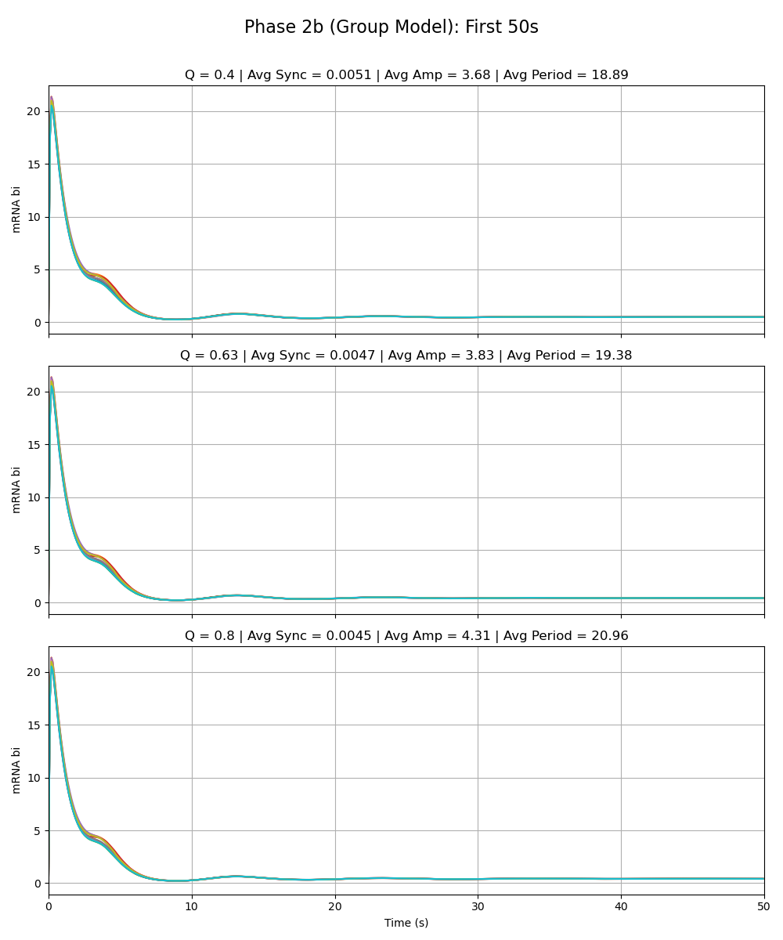
Notes:
alpha_y is 216

Slide 46
Olivia Phase 2a Model vs. Group Model Alpha_W = 0.01 Alpha_X = 0.01 Alpha_Y = 0.01 Alpha_Z = 216

Slide 47
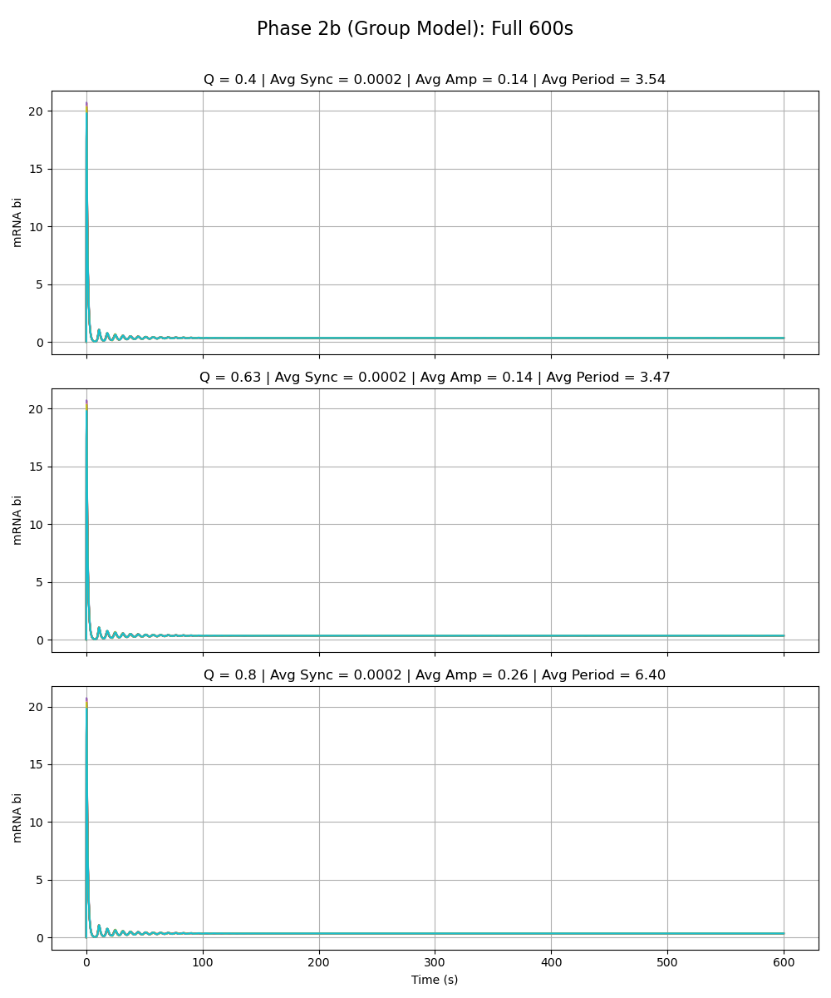
Notes:
alpha_z is 216

Slide 48
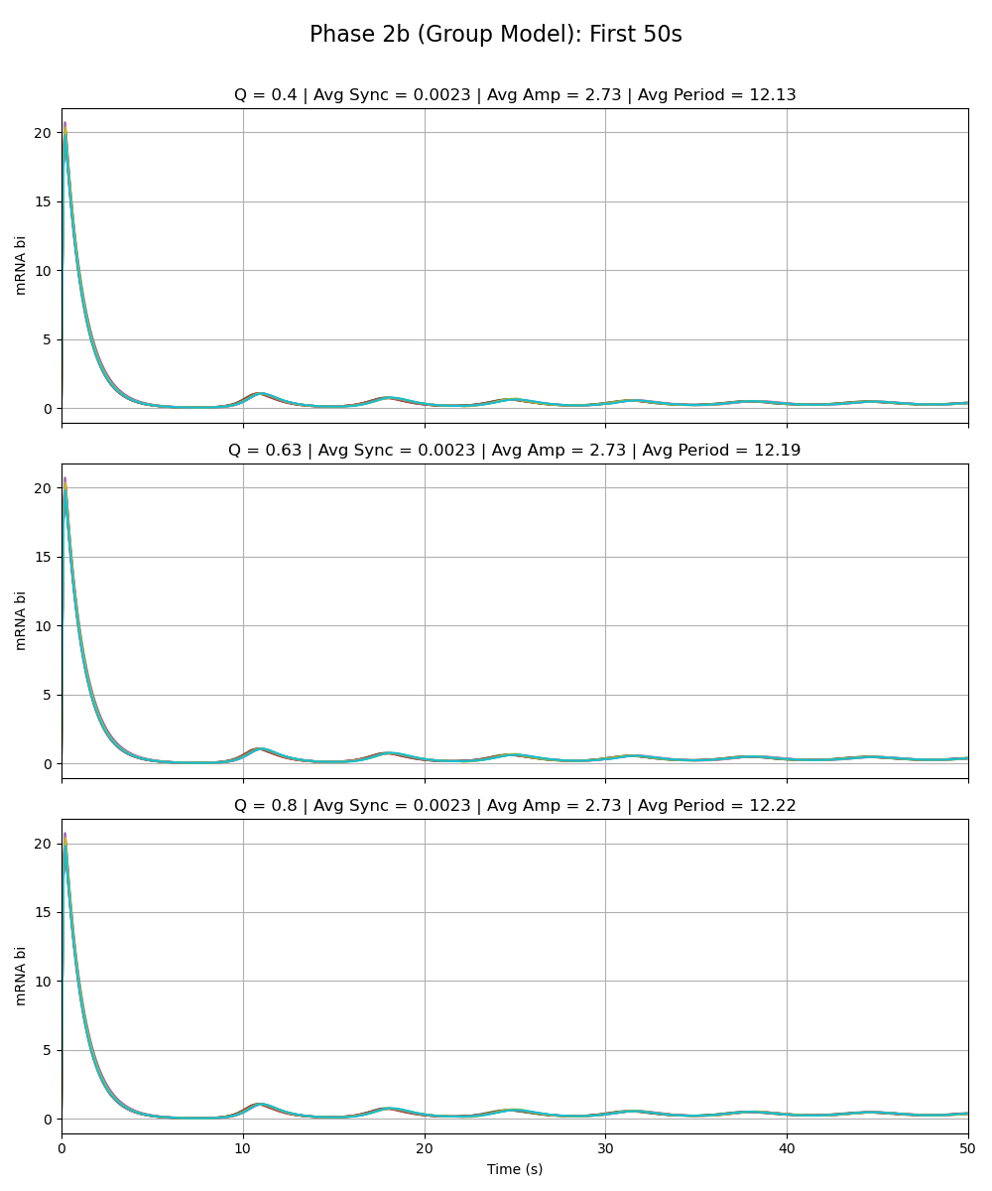
Notes:
alpha_z is 216

Slide 49
Phase 2b – Parameter Scan

Slide 50
Parameter Scan: Alpha_W
Q | Sync_Full | Amp_Full | Period_Full | Sync_0_50 | Amp_0_50 | Period_0_50 | Alpha_Value
0.4 | 0 | 0.09 | 2.53 | 0 | 1.86 | 4.53 | 0.84375
0.4 | 0 | 0.09 | 2.52 | 0 | 1.79 | 4.36 | 1.6875
0.4 | 0 | 0.09 | 2.52 | 0 | 1.71 | 4.07 | 3.375
0.4 | 0 | 0.09 | 2.54 | 0 | 1.75 | 4.29 | 6.75
0.4 | 0 | 0.09 | 2.54 | 0 | 2.15 | 5.15 | 13.5
0.4 | 0 | 0.09 | 2.53 | 0 | 1.83 | 4.4 | 27
0.4 | 0 | 0.09 | 2.54 | 0 | 2.12 | 5.2 | 54
0.4 | 0 | 0.09 | 2.53 | 0 | 1.88 | 4.57 | 108
0.4 | 0 | 0.09 | 2.53 | 0 | 1.86 | 4.48 | 216
0.4 | 0 | 0.09 | 2.52 | 0 | 1.98 | 4.72 | 432
0.4 | 0 | 0.09 | 2.52 | 0 | 1.78 | 4.3 | 864
0.4 | 0 | 0.09 | 2.51 | 0 | 1.8 | 4.49 | 1728
0.4 | 0 | 0.08 | 2.52 | 0 | 1.77 | 4.4 | 3456
0.63 | 0 | 0.06 | 1.74 | 0 | 1.69 | 4.1 | 0.84375
0.63 | 0 | 0.06 | 1.75 | 0 | 1.58 | 3.86 | 1.6875
0.63 | 0 | 0.06 | 1.75 | 0 | 1.57 | 3.84 | 3.375
0.63 | 0 | 0.06 | 1.75 | 0 | 1.57 | 3.8 | 6.75
0.63 | 0 | 0.06 | 1.74 | 0 | 1.73 | 4.18 | 13.5
0.63 | 0 | 0.06 | 1.75 | 0 | 1.71 | 4.13 | 27
0.63 | 0 | 0.06 | 1.75 | 0 | 1.76 | 4.38 | 54
0.63 | 0 | 0.06 | 1.74 | 0 | 1.74 | 4.21 | 108
0.63 | 0 | 0.06 | 1.74 | 0 | 1.72 | 4.21 | 216
0.63 | 0 | 0.06 | 1.75 | 0 | 1.92 | 4.81 | 432
0.63 | 0 | 0.06 | 1.75 | 0 | 1.84 | 4.54 | 864
0.63 | 0 | 0.06 | 1.75 | 0 | 1.66 | 4.17 | 1728
0.63 | 0 | 0.06 | 1.75 | 0 | 1.59 | 4.01 | 3456
0.8 | 0 | 0.06 | 1.84 | 0 | 2.61 | 6.49 | 0.84375
0.8 | 0 | 0.06 | 1.84 | 0 | 2.51 | 6.17 | 1.6875
0.8 | 0 | 0.06 | 1.84 | 0 | 3.12 | 7.22 | 3.375
0.8 | 0 | 0.06 | 1.85 | 0 | 3.19 | 8.26 | 6.75
0.8 | 0 | 0.06 | 1.8 | 0 | 2.34 | 5.81 | 13.5
0.8 | 0 | 0.06 | 1.85 | 0 | 3.52 | 8.6 | 27
0.8 | 0 | 0.07 | 1.87 | 0 | 3.04 | 7.12 | 54
0.8 | 0 | 0.06 | 1.82 | 0 | 2.68 | 6.46 | 108
0.8 | 0 | 0.07 | 1.87 | 0 | 2.62 | 6.62 | 216
0.8 | 0 | 0.06 | 1.83 | 0 | 2.89 | 7.58 | 432
0.8 | 0 | 0.06 | 1.86 | 0 | 2.84 | 6.89 | 864
0.8 | 0 | 0.06 | 1.81 | 0 | 2.59 | 6.82 | 1728
0.8 | 0 | 0.06 | 1.84 | 0 | 2.23 | 6.01 | 3456

Slide 51
Parameter Scan: Alpha_X
Q | Sync_Full | Amp_Full | Period_Full | Sync_0_50 | Amp_0_50 | Period_0_50 | Alpha_Value
0.4 | 0 | 0.03 | 2.19 | 0.04 | 1.26 | 8.44 | 0.84375
0.4 | 0 | 0.02 | 2.17 | 0.04 | 0.7 | 7.81 | 1.6875
0.4 | 0 | 0.01 | 2.15 | 0.04 | 0.39 | 8.09 | 3.375
0.4 | 0 | 0.01 | 2.13 | 0.03 | 0.16 | 6.79 | 6.75
0.4 | 0 | 0 | 2.08 | 0.02 | 0.11 | 5.55 | 13.5
0.4 | 0 | 0.01 | 2.07 | 0.02 | 0.16 | 5.54 | 27
0.4 | 0 | 0.01 | 2.06 | 0.01 | 0.17 | 5.87 | 54
0.4 | 0 | 0.01 | 2.11 | 0.01 | 0.19 | 6.64 | 108
0.4 | 0 | 0.01 | 2.11 | 0 | 0.18 | 5.92 | 216
0.4 | 0 | 0.01 | 2.05 | 0 | 0.18 | 6.21 | 432
0.4 | 0 | 0.01 | 2.1 | 0 | 0.18 | 6.23 | 864
0.4 | 0 | 0.01 | 2.1 | 0 | 0.15 | 5.69 | 1728
0.4 | 0 | 0 | 2.07 | 0 | 0.15 | 6.47 | 3456
0.63 | 0 | 0.02 | 1.98 | 0.03 | 1.27 | 8.98 | 0.84375
0.63 | 0 | 0.02 | 1.94 | 0.04 | 0.73 | 8.18 | 1.6875
0.63 | 0 | 0.01 | 1.93 | 0.04 | 0.39 | 8.43 | 3.375
0.63 | 0 | 0 | 1.91 | 0.03 | 0.16 | 7.58 | 6.75
0.63 | 0 | 0 | 1.89 | 0.02 | 0.08 | 5.76 | 13.5
0.63 | 0 | 0 | 1.87 | 0.01 | 0.14 | 6.43 | 27
0.63 | 0 | 0 | 1.92 | 0.01 | 0.16 | 6.62 | 54
0.63 | 0 | 0 | 1.89 | 0.01 | 0.16 | 6.5 | 108
0.63 | 0 | 0 | 1.87 | 0 | 0.16 | 5.89 | 216
0.63 | 0 | 0 | 1.9 | 0 | 0.18 | 7 | 432
0.63 | 0 | 0 | 1.91 | 0 | 0.17 | 6.85 | 864
0.63 | 0 | 0 | 1.89 | 0 | 0.15 | 6.37 | 1728
0.63 | 0 | 0 | 1.9 | 0 | 0.14 | 6.47 | 3456
0.8 | 0 | 0.04 | 2.93 | 0.03 | 1.4 | 9.76 | 0.84375
0.8 | 0 | 0.02 | 2.63 | 0.04 | 0.88 | 9.73 | 1.6875
0.8 | 0 | 0.01 | 2.6 | 0.04 | 0.46 | 9.58 | 3.375
0.8 | 0 | 0 | 2.43 | 0.03 | 0.2 | 9.23 | 6.75
0.8 | 0 | 0 | 2.28 | 0.02 | 0.09 | 7.44 | 13.5
0.8 | 0 | 0 | 2.35 | 0.01 | 0.14 | 7.8 | 27
0.8 | 0 | 0 | 2.61 | 0.01 | 0.17 | 7.92 | 54
0.8 | 0 | 0 | 2.61 | 0 | 0.19 | 8.33 | 108
0.8 | 0 | 0 | 2.62 | 0 | 0.19 | 7.82 | 216
0.8 | 0 | 0 | 2.62 | 0 | 0.19 | 7.91 | 432
0.8 | 0 | 0 | 2.66 | 0 | 0.19 | 8.12 | 864
0.8 | 0 | 0 | 2.27 | 0 | 0.17 | 7.95 | 1728
0.8 | 0 | 0 | 2.43 | 0 | 0.15 | 7.87 | 3456

Slide 52
Parameter Scan: Alpha_Y
Q | Sync_Full | Amp_Full | Period_Full | Sync_0_50 | Amp_0_50 | Period_0_50 | Alpha_Value
0.4 | 42.35 | 106.93 | 11.43 | 125.32 | 50.73 | 8.79 | 0.84375
0.4 | 13.56 | 78.81 | 10.84 | 36.11 | 46.04 | 8.57 | 1.6875
0.4 | 5.22 | 43.33 | 10.18 | 5.05 | 30.67 | 8.43 | 3.375
0.4 | 1.05 | 18.87 | 9.38 | 0.57 | 17.36 | 8.02 | 6.75
0.4 | 0.19 | 8.15 | 9.52 | 0.1 | 10.46 | 9.61 | 13.5
0.4 | 0.02 | 3.43 | 9.92 | 0.02 | 6.58 | 10.39 | 27
0.4 | 0 | 1.25 | 10.69 | 0.01 | 5.36 | 11.2 | 54
0.4 | 0 | 0.09 | 2.55 | 0.01 | 5.16 | 11.06 | 108
0.4 | 0 | 0.08 | 2.2 | 0.01 | 3.68 | 9.45 | 216
0.4 | 0 | 0.08 | 2.18 | 0.01 | 3.5 | 8.77 | 432
0.4 | 0 | 0.08 | 2.21 | 0.01 | 3.37 | 8.6 | 864
0.4 | 0 | 0.08 | 2.19 | 0 | 3.5 | 8.85 | 1728
0.4 | 0 | 0.08 | 2.15 | 0 | 3.65 | 9.04 | 3456
0.63 | 18.63 | 109.88 | 11.65 | 100.41 | 50.66 | 8.67 | 0.84375
0.63 | 7.41 | 82.46 | 11.08 | 23.31 | 51.12 | 9.38 | 1.6875
0.63 | 3.09 | 44.98 | 10.13 | 4.55 | 33.36 | 8.69 | 3.375
0.63 | 0.77 | 20.62 | 9.68 | 0.75 | 18.74 | 7.81 | 6.75
0.63 | 0.18 | 9.04 | 9.72 | 0.11 | 11.58 | 9.78 | 13.5
0.63 | 0.02 | 3.92 | 10.12 | 0.02 | 7.08 | 10.55 | 27
0.63 | 0 | 1.61 | 10.65 | 0.01 | 5.39 | 11.1 | 54
0.63 | 0 | 0.11 | 3 | 0 | 5.16 | 11.26 | 108
0.63 | 0 | 0.07 | 2.07 | 0 | 3.83 | 9.69 | 216
0.63 | 0 | 0.07 | 1.95 | 0.01 | 3.49 | 8.61 | 432
0.63 | 0 | 0.07 | 1.9 | 0 | 3.21 | 7.67 | 864
0.63 | 0 | 0.07 | 1.92 | 0 | 3.29 | 7.9 | 1728
0.63 | 0 | 0.07 | 1.94 | 0 | 3.25 | 8 | 3456
0.8 | 12.92 | 109.32 | 11.51 | 94.29 | 53.86 | 9.1 | 0.84375
0.8 | 5.23 | 82.74 | 10.96 | 15.32 | 49.73 | 9.01 | 1.6875
0.8 | 2.69 | 47.14 | 10.3 | 3.89 | 36.95 | 9.11 | 3.375
0.8 | 0.95 | 22.08 | 9.89 | 0.77 | 20.36 | 8.17 | 6.75
0.8 | 0.24 | 9.88 | 9.95 | 0.17 | 12.18 | 9.39 | 13.5
0.8 | 0.03 | 4.06 | 9.73 | 0.02 | 6.71 | 9.97 | 27
0.8 | 0 | 1.86 | 10.92 | 0.01 | 5.76 | 11.79 | 54
0.8 | 0 | 0.38 | 9.75 | 0 | 5.17 | 11.4 | 108
0.8 | 0 | 0.12 | 3.25 | 0 | 4.31 | 10.48 | 216
0.8 | 0 | 0.1 | 2.95 | 0.01 | 4.16 | 10.22 | 432
0.8 | 0 | 0.09 | 2.46 | 0 | 4.11 | 9.9 | 864
0.8 | 0 | 0.09 | 2.49 | 0 | 4.22 | 9.92 | 1728
0.8 | 0 | 0.09 | 2.45 | 0 | 4.15 | 9.87 | 3456

Slide 53
Parameter Scan: Alpha_Z
Q | Sync_Full | Amp_Full | Period_Full | Sync_0_50 | Amp_0_50 | Period_0_50 | Alpha_Value
0.4 | 34.59 | 89.37 | 12.11 | 103.42 | 44.38 | 10.99 | 0.84375
0.4 | 4.23 | 49.64 | 12.32 | 6.42 | 33.81 | 11.11 | 1.6875
0.4 | 0.68 | 19.83 | 11.35 | 0.31 | 17.99 | 10.44 | 3.375
0.4 | 0.04 | 3.58 | 10.19 | 0.01 | 7.51 | 10.02 | 6.75
0.4 | 0 | 0.08 | 2.1 | 0 | 2.03 | 4.31 | 13.5
0.4 | 0 | 0.08 | 2.15 | 0 | 2.7 | 5.72 | 27
0.4 | 0 | 0.1 | 2.48 | 0 | 3.21 | 7.15 | 54
0.4 | 0 | 0.12 | 2.89 | 0 | 2.96 | 6.4 | 108
0.4 | 0 | 0.14 | 3.54 | 0 | 2.73 | 6.06 | 216
0.4 | 0 | 0.18 | 4.61 | 0 | 2.36 | 5.55 | 432
0.4 | 0 | 0.22 | 5.55 | 0 | 2.47 | 6.36 | 864
0.4 | 0 | 0.22 | 5.99 | 0 | 2.59 | 6.84 | 1728
0.4 | 0 | 0.21 | 5.91 | 0 | 2.47 | 6.63 | 3456
0.63 | 11.54 | 91.24 | 12.35 | 68.08 | 43.31 | 10.67 | 0.84375
0.63 | 1.87 | 49.3 | 12.25 | 4.64 | 35.13 | 11.54 | 1.6875
0.63 | 0.54 | 20.14 | 11.53 | 0.26 | 18.69 | 10.84 | 3.375
0.63 | 0.05 | 3.61 | 10.26 | 0.01 | 7.27 | 9.6 | 6.75
0.63 | 0 | 0.07 | 1.82 | 0 | 3.18 | 6.47 | 13.5
0.63 | 0 | 0.08 | 2.02 | 0 | 2.5 | 5.4 | 27
0.63 | 0 | 0.1 | 2.5 | 0 | 3.18 | 7.07 | 54
0.63 | 0 | 0.11 | 2.83 | 0 | 2.99 | 6.53 | 108
0.63 | 0 | 0.14 | 3.47 | 0 | 2.73 | 6.09 | 216
0.63 | 0 | 0.19 | 4.68 | 0 | 2.53 | 5.9 | 432
0.63 | 0 | 0.22 | 5.59 | 0 | 2.47 | 6.36 | 864
0.63 | 0 | 0.23 | 6 | 0 | 2.53 | 6.58 | 1728
0.63 | 0 | 0.22 | 5.97 | 0 | 2.54 | 6.82 | 3456
0.8 | 6.74 | 89.59 | 12.11 | 45.06 | 42.73 | 10.49 | 0.84375
0.8 | 1.28 | 48.56 | 12.07 | 3.64 | 34.03 | 11.17 | 1.6875
0.8 | 0.39 | 20.23 | 11.57 | 0.25 | 19.1 | 11.08 | 3.375
0.8 | 0.03 | 3.65 | 10.35 | 0.01 | 7.67 | 10.23 | 6.75
0.8 | 0 | 0.08 | 2.1 | 0 | 4.66 | 9.38 | 13.5
0.8 | 0 | 0.11 | 2.71 | 0 | 3.82 | 7.83 | 27
0.8 | 0 | 0.15 | 3.73 | 0 | 3.17 | 7.05 | 54
0.8 | 0 | 0.21 | 5.43 | 0 | 3.04 | 6.61 | 108
0.8 | 0 | 0.26 | 6.4 | 0 | 2.73 | 6.11 | 216
0.8 | 0 | 0.25 | 6.25 | 0 | 2.53 | 5.97 | 432
0.8 | 0 | 0.24 | 6.17 | 0 | 2.41 | 6.24 | 864
0.8 | 0 | 0.23 | 6.05 | 0 | 2.52 | 6.65 | 1728
0.8 | 0 | 0.21 | 5.78 | 0 | 2.55 | 6.84 | 3456

Slide 54
Phase 2b Summary

Slide 55
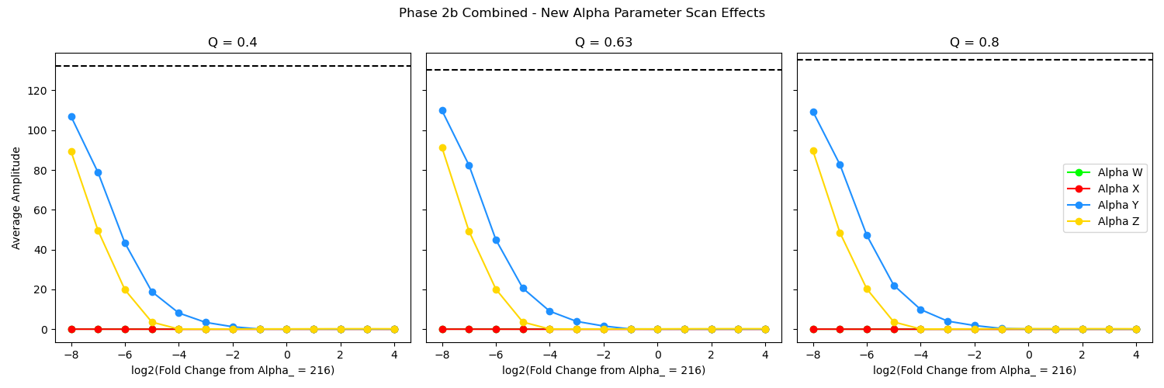
Adding Node Y (parameter sweep of alpha y) has the smallest effect on the group model, followed by Node Z, with Nodes W and X having the most drastic effect.

